Slide 2
Today’s Discussion
What is the problem?
What are the consequences?
How does it happen?
What can you do about it?

Slide 3
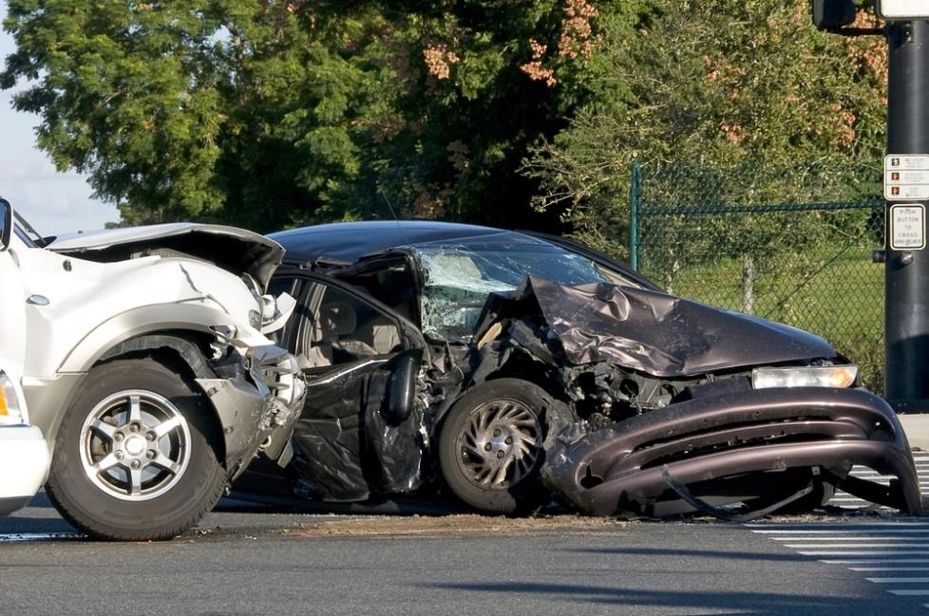
WHY?
Crashes
More than 6,300 injuries and 100 deaths daily.

Slide 4
THE PROBLEM
Speed
Speeding directly contributes to traffic injury severity and is involved in one-third of all U.S. traffic fatalities.

Slide 5
THE PROBLEM
Attention
It is impossible for the human mind to fully focus on two tasks at once.

Slide 6
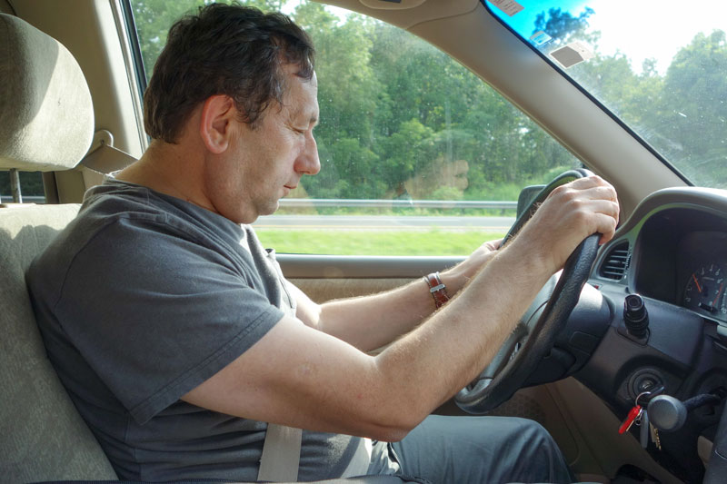
THE PROBLEM
Fatigue
Driving on six hours of sleep almost doubles your chances of being involved in a motor vehicle crash.

Slide 7
THE PROBLEM
Emotion
Aggressive Driving played a role in 56% of fatal crashes.

Slide 8
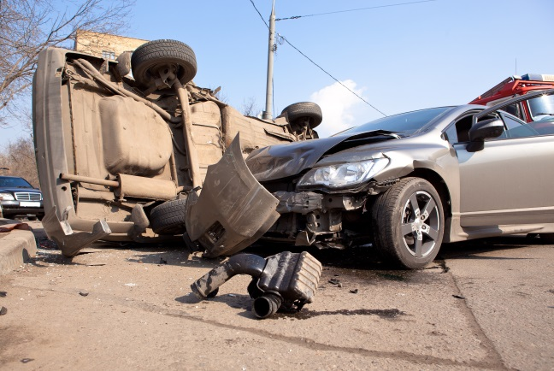
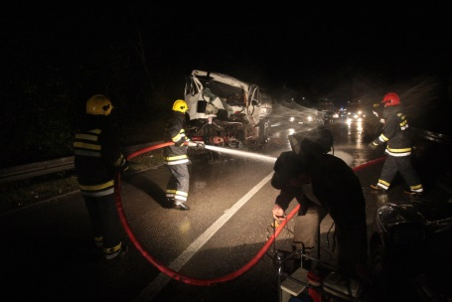
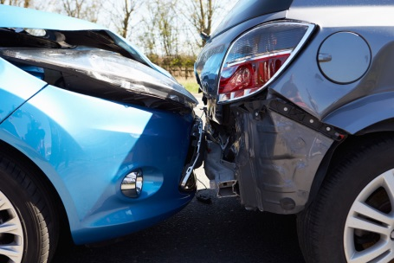
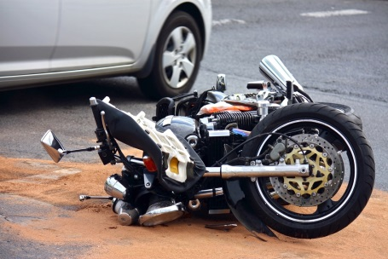
CRASHES
Are they preventable?

Slide 10
The Problem SPEED
Traffic conditions
Weather and visibility
Perceptions
Legal speed limit
Road conditions and configuration

Slide 11
Ask Yourself …
Speed Survey
Do you accelerate when a traffic light turns yellow?
Do you decrease your speed during bad weather or in a road construction zone?
Do you make a full stop at stop signs?

Slide 12
Changing Behavior SPEED
Posted speed, ticket speed and safe speed
Deliberate speeders
Set the example

Slide 13
The Problem ATTENTION
Space management
Multi-tasking
Perceptions
Communication
Hazard detection and visual scanning

Slide 14
Ask Yourself …
Attention Survey
Do you multi-task (use mobile device, GPS, eat, etc) while driving?
Do you ever closely follow the vehicle in front of you?
Do you pass even when visibility is obscured?

Slide 15
Changing Behavior ATTENTION
Beware of others
Changing road conditions
Constantly monitor traffic conditions
Set the example

Slide 16
The Problem FATIGUE
Extreme driving conditions
Perceptions
Sleep routine
Night operation
Signs of fatigue

Slide 17
Ask Yourself …
Fatigue Survey
Do you drive when sleepy and find it hard to keep your eyes open?
Have you ever been unable to recall changing lanes?
Do you stay up late and go to work tired?

Slide 18
Changing Behavior FATIGUE
There is no substitute for rest
Have the right equipment for the conditions
Avoid overnight driving if possible
Set the example

Slide 19
The Problem EMOTION
Intrusive responses
Perceptions
Emotional factors
Territorial defensiveness

Slide 20
Ask Yourself …
Emotion Survey
Do you take more risks when you are in a hurry?
Do you yell or honk at other drivers that make you angry?
Do you drive without wearing a safety belt?

Slide 21
CHANGING BEHAVIOR – EMOTION
Don’t provoke others
Understand your triggers
Focus on what you can control
Set the example

Slide 22
Do You Believe …
You can change your employees’ attitudes and behaviors?
We Believe!

Slide 23
CONSEQUENCES
Jury awards and settlements cost businesses billions of dollars!
Bodily injury
Pain and suffering
Medical costs
Mental anguish
Disability benefits
Legal fees
Survivor benefits
Punitive damages
Loss of income

Slide 24
CONSEQUENCES
Vicarious Liability & Negligent Entrustment

Slide 25
CONSEQUENCES
Beyond the courtroom!
Who didn’t make it home?
Who can no longer walk?
Who will live with chronic pain?
Who buried a child or loved one?
Whose life was changed forever?

Slide 26
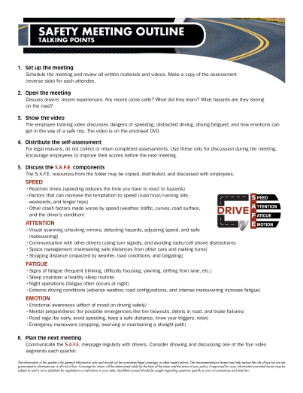
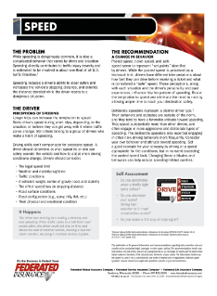
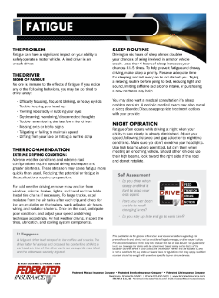
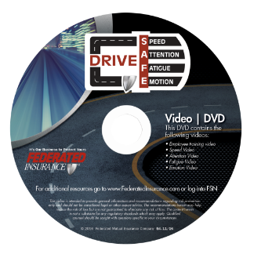
Businesses Leaders
Discuss with your employees

Slide 27
EMPLOYEE MEETING
SPEED

Slide 28
DAILY REMINDERS

Slide 29
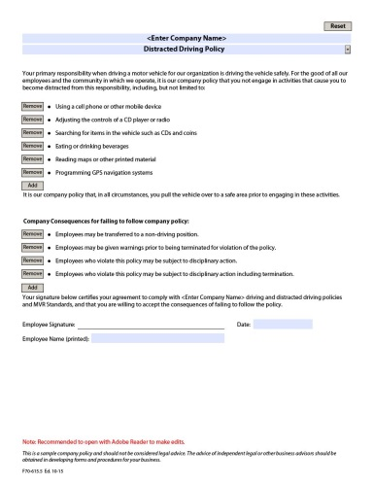
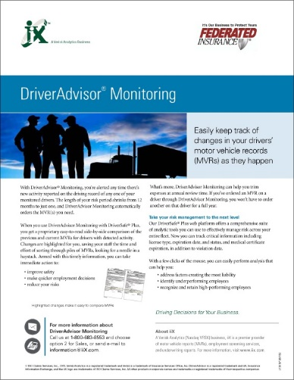
Business Leaders
Have a policy
Screen and monitor your drivers

Slide 30
Driving UN-S.A.F.E
Is it worth killing for?
Is it worth dying for?

Slide 31
QUESTIONS?
USA Today article at http://usat.ly/2gKoLQD. AAA Foundation for Traffic Safety, Acute Sleep Deprivation and Risk of Motor Vehicle Crash Involvement Fact Sheet, page 2. https://www.aaafoundation.org/sites/default/files/AcuteSleepDeprivationCrashRiskFS.pdf
National Highway Traffic Safety Administration. Motivations for Speeding, DOT HS 811 672. October 2012.
National Highway Traffic Safety Administration. Motivations for Speeding—Additional Data Analysis,
DOT HS 812 250. March 2016.

Slide 32
Thank You!
This presentation is for general information and risk prevention only and should not be considered legal or other expert advice. The information herein may be subject to, and is not a substitute for, any laws or regulations that may apply in your state. The recommendations herein may help reduce but are not guaranteed to eliminate any or all risk of loss. Qualified counsel should be sought with questions specific to your circumstances.

