Slide 1
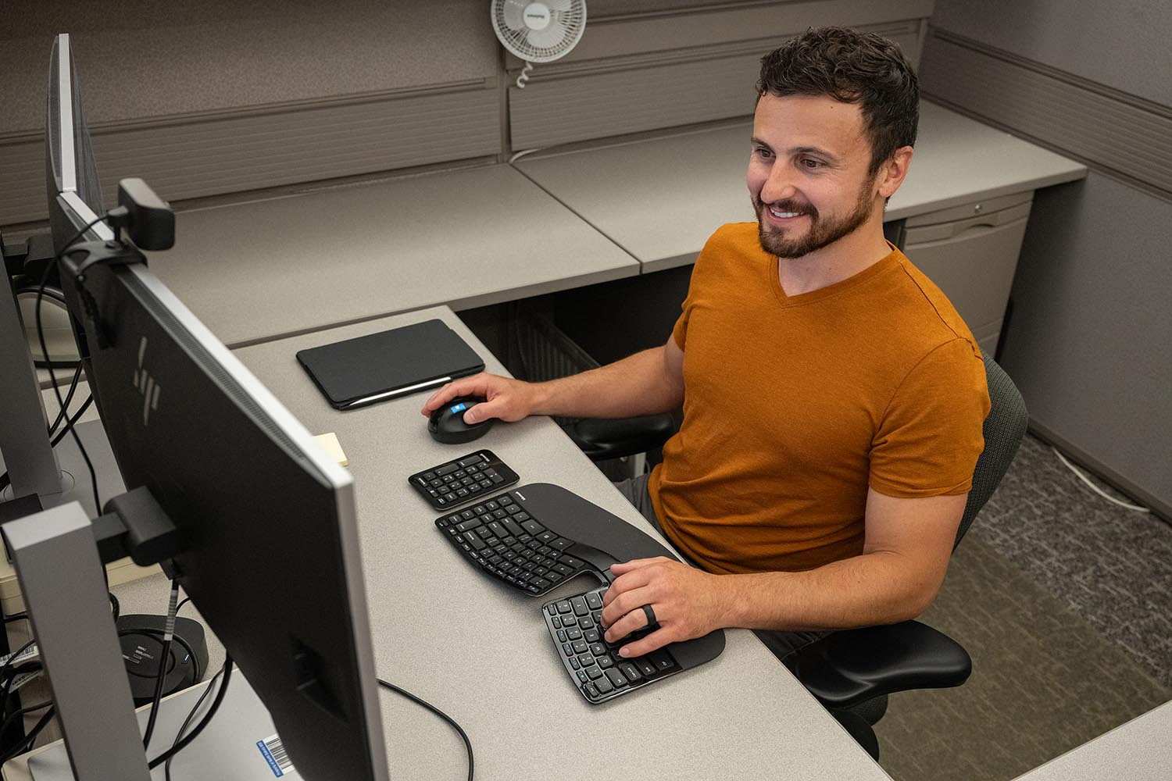
ERGO Initiative Program

Slide 2
Goal and Takeaway
Goal
Introduce the ergonomic grant program or refresh viewers on what it is, how it works, and how to apply
Takeaway
Gain a better understanding of the program to decide if you would like to participate

Slide 3
PHASE III
OPENED FALL ‘21
Notes:
Third time ergonomic grant was opened.

Slide 4
What is the Ergonomic Grant Program?
A proactive program designed to reduce the frequency or eliminate work-related ergonomic injuries.
Provides employers with resources, including a network of providers and financial assistance, to address ergonomic issues.
Sentence or two can go here or, three bullet points.
Notes:
How many have participated?
Since 2009

Slide 5
Why does the Ergonomic Grant Program Exist?
More efficient
Cost savings
Awareness
People are getting hurt

Slide 6
Did You Know…
Cumulative trauma injuries are the nation’s most common and costly occupational health problem.
Cumulative Trauma Injuries Cost
Direct Costs: More than $20 billion per year
Total Costs: $45-54 billion per year
~ Bureau of Labor Statistics-2020

Slide 7
Claims Stats in ND
ND
Ergonomic Related Injuries
ON AVERAGE
30-35%
6,000-8,000
ALL CLAIMS REPORTED
CLAIMS FILED PER YEAR
Notes:
Same percentage nationally
4 categories…carpal tunnel, sprains/strains, cumulative, cumulative all other
Ergonomic related injuries account for approximately 30–35% of all claims reported in North Dakota

Slide 8
Medical Only Claims – Average Severity (As of 6/30/2023)

Slide 9
Excluding Medical Only – Average Severity (As of 6/30/2023)

Slide 10
#1 Submit an Ergonomic Initiative Application
Who is eligible?
Available to all North Dakota employers who have a current WSI account that is in good standing. (not in collections)

Slide 11
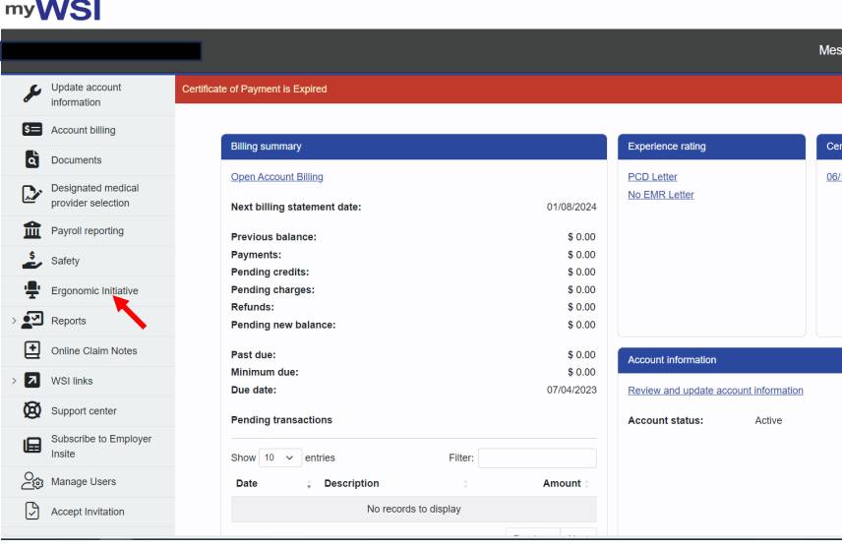
myWSI Landing Page
Must have either the myWSI account administrator role or the ergonomic grant role assigned to you.

Slide 12
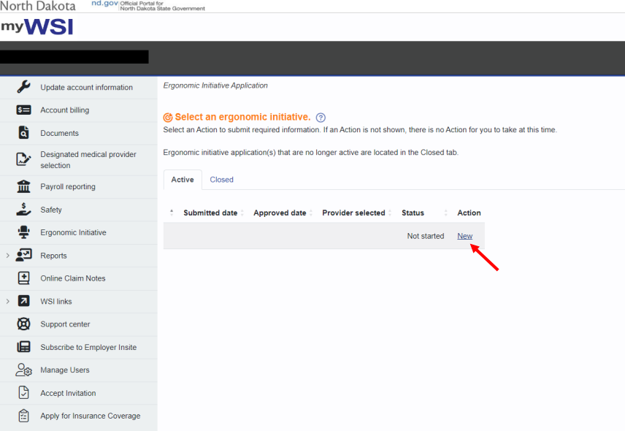
EI Landing Page

Slide 13
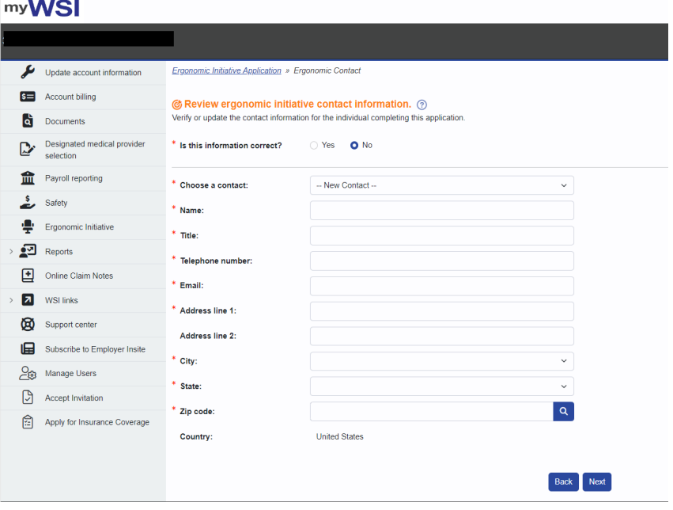
EI Application

Slide 14
#2 Select your ergonomic
initiative provider
Provider Services:
On-Site Assessments
Education Training
Equipment Research
Grant Assistance
WSI pays:
75% of the onsite time, doc, research
75% of mileage & travel time if applicable
100% of educational related services

Slide 15
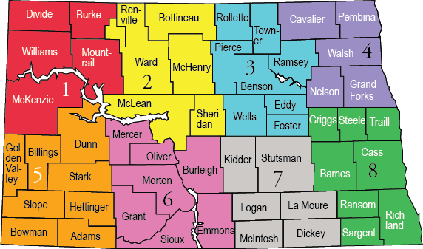
Participating ERGO Providers
20 Medical Providers
Over 30 Therapists, including Occupational Therapists & Physical Therapists
Notes:
Remove all providers

Slide 16
#3 Submit your grant request
Who is eligible?
Completed the ergo assessment through the program.
Have a WSI account that is active and in good standing for at least one year.

Slide 17
EI Landing Page (after assessment)

Slide 18
Grant Request (budget)

Slide 19
Grant Awards
WSI contributes 75%, up to the maximum award amount
Premium Size $250–$5,000 $5,001–$20,000 $20,001–$50,000 $50,001–$150,000 $150,001–$300,000 $300,001 & Above
Grant Award $5,000 $10,000 $15,000 $20,000 $30,000 $50,000
Award amount is based on standard premium for the most recently completed premium year

Slide 20
Ergonomic Grant Program Contact
Randy Wegge Loss Control Ergonomics Manager
800-777-5033 l rwegge@nd.gov

Slide 21
Thank you!

