Slide 1
www.
workforcesafety.com
Notes:
CLICK-** Our Purpose is to Care for Injured Workers
CLICK-** Our Strategy is to have exceptional People, Provide Exceptional Service and maintain Financial Stability
CLICK-** Our Business is to provide workers’ compensation and safety services
CLICK-** And our Core Values are to be Loyal, Caring and Forthright

Slide 2
North Dakota Workers’ Compensation Background
Where every North Dakota worker deserves a safe work environment, and every employer deserves to have healthy workers safely on the job without the risk of workplace injury.
Workforce Safety and Insurance (WSI) was established in 1919 as an exclusive state fund for workers’ compensation insurance.
Notes:
A little of our background for them….
• We want every worker to arrive and leave work safely by having a safe work environment without of an injury
• We were established in 1919 as a monopolistic fund, meaning we handle all work related insurance coverage for employees in ND
• No fault insurance so by having a WSI account employers are protected from being sued by their employees for work related injuries

Slide 3
North Dakota Workers’ Compensation Background (cont.)
Claims for occupational injury and disease are filed with WSI and adjudicated by in-house agency claim adjustors.
WSI is a special fund agency funded solely by employer premiums.
Notes:
more background…..
This WSI fund is provided by employer premiums
We service about 20,000+ employer accounts annually and have approximately 50+ claims adjusters
All claims are adjudicated by our in-house claim adjustors

Slide 4
Partnering with WSI:
Improving Safety Performance and Reducing Costs
www.
workforcesafety.com
Notes:
• The main area that deals with our safety programs is Loss Control.
• We have various staff located throughout ND to assist our employers.

Slide 5
WSI Loss Control Safety & Education
Safety Management Program (SMP)
Safety Action Menu (SAM)
Safety Consultation
Loss Control Assessments
Learning Management System (LMS)
Video Resource Library
OSHA 10 Hour Online Training
Ergonomic Initiative Grant
Notes:
The LC division of WSI offers two different types of safety discount programs-SMP/SAM.
• SMP = a 10% discount program
• SAM = 8 different 5% SAM programs available.
• Each yr, you can qualify for the SMP and 3 of the SAM choices for a possible combined total of 25%.
• Our Safety consultants do inspections, accident investigations and provide other assistance throughout the yr.
• We have a dedicated staff person (Nicole Gaab) who will provide assessments on your account.
• We offer both a hardcopy VRL and online LMS at no cost for safety training.
• We offer OSHA 10 hour online Construction or General Industry training
• We offer Grant funding for Employers and Associations.

Slide 6
WSI Loss Control Safety Consultant Service Areas
REGION #1
Williston
REGION #2
Minot
REGION # 3
Devils Lake
REGION # 4
Grand Forks
REGION # 5
Fargo
REGION # 6
Jamestown
REGION # 7
Bismarck
REGION # 8
Dickinson
www.
workforcesafety.com
Notes:
• Regional map of ND where we have 13 SC’s and 2 SC Supervisors positioned to provide assistance.
• We have this color coded for visual ease and it is placed out under the Safety/Professional Safety Services area of our website.
• The website map is broken down by region and has the consultant’s phone, email and city information.

Slide 7
Designed to assist employers in developing or improving current safety management systems.
Employers who successfully participate in WSI’s SMP can receive a premium discount of 10%.
www.
workforcesafety.com
Notes:
• Safety Management Program or (SMP) is one of our 2 discount programs worth 10% if all the requirements are met.
• Enroll or renew into the pgm prior to the beginning of your premium period.
• A consultant will work with you on developing or enhancing a current program so it meets the program requirements.
• The discount is awarded at the end of the premium period.

Slide 8
S.M.P. Committed Management
Develop safety policy
Identify proactive safety goals
Provide resources
Measure safety performance
Support safety enforcement
Assign safety and claims coordinator
Notes:
• 1st step for a successful SMP is Mgmt Commitment.
• Develop a policy that outlines your company’s objectives.
• This includes goals and any resources that assist with this effort.
• Any program should be measurable and indicate how sfty is enforced.
• It is essential you have a safety and/or claims coordinator to oversee your pgm.

Slide 9
S.M.P. Safety Training
Implement safety training program
Meet federal and state safety training requirements
New employee training process
Notes:
• A good SMP includes Safety Training
• Federal and state requirements are a must
• New staff should be trained right away so they know what your expectations are regarding safety.

Slide 10
S.M.P. Hazard Recognition
Procedures for inspection
Inspect entire workplace at least four times per year
Documentation, review and sign off by employer
Implement corrective actions and monitor process
Conduct performance evaluation
Notes:
• Another component of the SMP is being able to recognize hazards.
• Having inspection steps that include workplace walk throughs a minimum of 4 times a yr.
• WSI relies on documentation to show these reviews are done with employer sign off to show a good support system.
• You need to identify and then put into place steps to correct hazards and keep an eye on how the process goes.
• There should be a performance evaluation done to reinforce this process.

Slide 11
S.M.P. Accident Investigation
Implement a written program
Identify Root Causes (s)
Conduct investigation for WSI claims
Implement corrective actions and monitor process
Conduct performance evaluations
Notes:
• Part of the SMP program is having a written program showing how you investigate accidents.
• A big part of this is determining the root cause(s) by investigating all WSI claims.
• This again involves the monitoring of any corrections you have done and doing evaluations on this performance.

Slide 12
S.M.P. Annual Safety/ Claims Seminar
Management, safety and claims representative attend one seminar per year
Notes:
• The final component is that your claims and safety representatives attend one seminar a year.
• Some ideas for this can be a WSI online WebEx
• Being a member of the area Sfty Assn and attending at least 6 of their 12 monthly mtgs
• Participation in an industry specific conference or sfty training.
• Your sfty consultant can also work with you on more ideas to meet this requirement.

Slide 13
Designed to provide employers with options that allow them to choose and implement safety improvement programs that meet their business needs.
Employers can receive up to a 15% premium discount by successfully participating in the SAM programs.
www.
workforcesafety.com
Notes:
• Safety Action Menu or SAM is the 2nd of our two discount programs
• These are done more independently of your safety consultant but they are still available to assist you with questions.
• You enroll in these at the beginning of your premium period as they are an annual discount program.
• They are each worth 5% and successfully completing 3 of these by the end of your premium period will provide you a 15% discount.

Slide 14
S.A.M. Safety Committee Program
Establish a committee charter
Employer and employee representation
Meet at least monthly
Provide safety training to members
Notes:
• The Safety Committee pgm requires a committee charter with an equal # of employer/employees.
• The committee should meet at least monthly.
• For 1st yr participants, the first meeting s/b within the 1st 90 days.
• If you are renewing the 2nd yr, the first meeting should be from the start of the premium period.
• All members need sfty trg and the committee should maintain minutes for each mtg.

Slide 15
S.A.M. Certified Safety Management Program
OSHA Safety and Health Recognition (SHARP)
OSHA Voluntary Protection Program (VPP)
Occupational Health and Safety Assessment Series Certifications (OSHAS 18001)
Rural Electric Safety Accreditation (RESAP)
Associated Builders and Contractors, Inc. (ABC), Gold or higher Safety Training Evaluation Process (STEP)
Notes:
• The Certified Sfty Mgmt Pgm is more of a recognition discount by WSI for employers attaining one of these listed items.
• These reflect the employer is already dedicated to a safe work environment and have meet some pretty stringent requirements.

Slide 16
S.A.M. Safe Driver Program
Safe vehicle operational policy
Vehicle maintenance program
Driver safety training program
Notes:
• The Safe Driver program requires a policy and annual checkpoint maintenance pgm.
• As long as these requirements along with defensive driver training is completed you should be on track for this program.
• The driver training is only required every 3 years but the other pgm requirements need to be completed on an annual basis.

Slide 17
S.A.M. Drug-Free Workplace Program
Written Drug-Free Workplace Program
Required Drug and Alcohol Testing
Supervisor Training
Employee Training
Employee Assistance Program (EAP)
Notes:
• Another SAM choice is the Drug-Free Workplace Pgm which also requires a written pgm that outlines for your employees the testing method you use.
• Annual training is required for both Supervisors and employees which is documented and signed off on by all parties showing you have completed the training.
• Although we don’t require the Employer to pay for an Employee Assistance Pgm we do ask that information on available EAP services is provided to staff.

Slide 18
S.A.M. Safe Lift Program
Safe Lift Committee
Conduct a facility wide audit to identify risk of lifting injury
Develop action plans to reduce risk
Implement plan
Measure success
Notes:
• The Safe Lift pgm should have a committee that meets at least monthly.
• An audit of your facility is required in order to see what lift risks there may be and then having a plan in place to reduce those risks. • Make sure to implement the plan and always show how you measure any success on avoiding injuries.
• (If you are in both the Safety Committee and Safe Lift pgm’s, you can have the same representatives but will need to keep separate minutes for each committee).

Slide 19
Learning Management System (LMS)
Attend “Train-the-Trainer” workshop
Employer self administers the LMS
Employee participation is based on employer size
Active employees complete one course per quarter
www.
workforcesafety.com
Notes:
• The LMS is our online Learning Management System which is available to employers with a ND policy in good standing.
• Only employees working in ND and reported on the annual pyrl report can utilize this system.
• The employer would identify a company representative to attend a one time WebEx training. That person will be the LMS Administrator over their learners.
• We use the most recent completed premium period of an employers payroll information to determine a required participation level based on their size.
• Those same employees once identified would need to complete a minimum of one course per qtr throughout the yr, unless you have turnover. Then a substitute needs to be identified to finish out the yr.
• We have over 450 courses on the system and this year launched a new platform.

Slide 20
S.A.M. Safety Orientation System
Safety mentoring
Provide mentoring to each new employee
Document mentoring process
Seek and document feedback from new employees
New employees will participate a minimum of three months
Notes:
• The Safety Orientation System is a mentoring pgm.
• The pgm requires new employees be assigned a mentor who will keep track of the mentoring activity for at least 3 months.
• It is important the mentor and mentee communicate and document the success of this interaction.
• Hazards, sfty concerns and near-misses should be reviewed along with reporting those incidents and injuries.
• The mentor should also share the Emergency Response Procedures and RTW procedures.
• All Occupational Safety & Health Administration or OSHA and Mine Safety & Health Administration or MSHA training should be conducted and documented.

Slide 21
North Dakota Workers’ Compensation Return to Work/Designated Medical Provider
Return to Work Program
Implement written policy
Identify roles and responsibilities
Work related incident procedure
Establish Transitional Duty procedure
Forms
Education/Training
Designated Medical Provider
Select, Inform, Educate
Notes:
• The Return to Work/Designated Medical Provider program requires a written policy and all roles and responsibilities of your staff should be identified.
• This includes procedures for injuries, education on transitional work and each year review of the RTW information to include the designated medical provider for your staff.
• This education needs to be done annually and documented so they know what to do in the event of an injury and what to expect while they are recovering.
• We have overview courses for each of our SAM program on the LMS for first year participants to help them understand the program requirements and their role.

Slide 22
Loss Control Safety Consultation
Educate employers on safety incentive program requirements, implementation and maintenance
Safety Management System development
Develop safety courses, plans and programs
Safety inspections and Accident investigations
Assist in developing JSA’s and JHA’s
Notes:
CLICK- • As mentioned earlier your Safety Consultant is a great resource to provide assistance on developing your SMP and SAM pgm’s.
CLICK- • They are always willing to visit with you either by phone or on sight to identify possible risks.
CLICK- • They can also help you with developing Job Sfty Analysis or Job Hazard Analysis plans.

Slide 23
Loss Control Assessments
Trend Analysis Reports
Loss Control Assessment/Reports
Frequency/Severity reports
Loss Control policy & procedure review
What-if Emod/Scenarios
Reducing your experience rate can save $$$$$
Notes:
• Nicole Gaab is our Loss Control Consultant and heads up this service.
• There is no cost to have her take a specific look at a companies book of business with regard to claim activity.
• She will work with employers to identify any trends that may be occurring due to claim activity and make recommendations on corrections.
• If you’ve never had a trend analysis done her report will shed some light on what might be driving your claim costs and ways to reverse this situation.
• She can pull some what-if experience modification information on claims to see how not having an injury can positively affect your bottom line for cost.

Slide 24
LMS
Learning Management System)
OSHA Essentials
Construction
Driver/Transportation
Emergency Preparedness
Ergonomics
Environmental
Food Services
Health and Wellness
Healthcare
Laboratory
Semiconductor
Supervisor
Telecommunications
450+ free online safety training courses
www.
workforcesafety.com
Notes:
The LMS offers 5 main options to Employers:
• Apply for the LMS Safety Discount menu item
• Use the LMS in conjunction with our Safe Driver Discount menu item
• Use on a stand-alone basis outside of any discount parameter
• Individual Learner
• New this year-New Hire Training Option (choose from pre-selected curricula’s or create one from catalog that meets their needs)
WSI would create and assign to New Hires. If other learning is desired, revert to having a LMS Admin trained for full catalog access.
• 450+ course titles in multiple categories and in English & Spanish

Slide 25
Video Resource Library 600 + titles on safety training
Bloodborne Pathogens/First Aid
Chemical Safety
Confined Space
Construction
Cranes/Forklifts/Rigging/Oil Well
Driver Training
Electrical Safety
Ergonomics
Fall Protection
Fire/Emergency
General Safety
Grain Handling Safety
Hazardous Materials
Healthcare Industry
Laboratory
Lockout/Tagout
Personal Protective Equipment
Scaffolding
Substance Abuse
Supervisory Training
Tool and Machine Safety
Welding and Cutting
Notes:
• With 600+ DVD/VHS materials, an employer has a wealth of information available to check out for group training.
• This is another free resource and is the compliment to the online LMS training option.
• Our goal is to eventually provide group training on the LMS so employers can project a course to multiple employees and keep a roster for tracking purposes.
• For now they can check out hardcopy selections for a couple of weeks with the list on our website.
• These will be mailed out or we offer front desk pickup for employers in the Bismarck area.

Slide 26
Loss Control OSHA Online
Any ND employer (who has a policy with WSI) and their ND employees are eligible to take the course.
General Industry
Construction
Complete within 6 months.
OSHA 10 Hour Card
www.
workforcesafety.com
Notes:
• In addition to the LMS, WSI offers free OSHA 10 hour online training.
• We provide both General Industry and Construction courses to those ND employers with a policy in good standing for their ND employees.
• Out on our Website under Safety/Safety Training & Education you will find the information.
• We have Elizabeth Johnson who oversees this program and she would be happy to answer any questions you may have on the pgm.

Slide 27
ERGONOMIC
INITIATIVE/
GRANT
PROGRAM
www.
workforcesafety.com/employers/safetygrants

Slide 28
WHAT IS IT?
A proactive program designed to reduce the frequency or eliminate work-related MSDs
* Available to all ND employers who have a current WSI account that is in good standing

Slide 29
WHY?
More efficient
Cost savings
Awareness
People are getting Hurt

Slide 30
DID YOU
KNOW
Cumulative Trauma injuries are the nations most common and costly occupational health problem
More than $20 billion a year in workers’ compensation
~ U.S. Dept. of Labor 2010

Slide 31
CLAIMS
STATS in ND
Ergonomic Related injuries account for approx. 30% - 35% of all claims reported in North Dakota
On average – that is roughly 9000 claims per year

Slide 32
Medical Only Claims Average Claim Cost
Average Severity – As of 6/30/2017

Slide 33
Time Loss Claims Average Claim Cost
Average Severity – As of 6/30/2017

Slide 34
On-site
Ergonomic
Services
Financial Assistance –
3:1 match
ERGO
PROGRAM
COMPONENTS
Provider “Network”
Grant
Eligibility

Slide 35
Ergonomic Initiative Program Provider Network
Utilize 19 Medical Providers throughout the state
Over 30 Therapists… primarily OTs & PTs

Slide 36
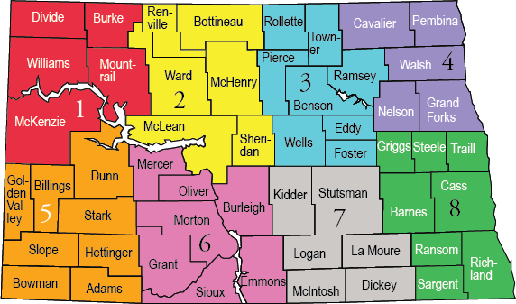
REGION 4
Achieve Therapy
Altru Health
Blue Water Therapy
Essential Health
Riverview Healthcare
Sanford Occ. Health
Pro Rehab PT & Occ.
REGION 3
Achieve Therapy
Altru Health
Blue Water Therapy
Central Dak PT CHI St Alexius
First Choice
Heart of America
Sanford Occ. Health
Trinity Health
REGION 1
First Choice PT Live in Motion PT
Sanford Occ. Health
Therapy Solutions
Trinity Health
REGION 2
AIM PT
Central Dakota PT
First Choice PT
Heart of America
Sanford Occ. Health
CHI St. Alexius
Therapy Solutions
Trinity Health

Slide 37
REGION 8
Achieve Therapy
Altru Health
Blue Water Therapy
Central Dakota PT
Essentia Health
Fargo Ergo
Mobility PLUS
OSPTI
Pro Rehab
Riverview Healthcare Sanford Occ. Health
REGION 7
Achieve Therapy
AIM PT
Blue Water Therapy
Central Dakota PT CHI St. Alexius
Essentia Health
Fargo Ergo
Heart of America
Mobility PLUS
Sanford Occ. Health
REGION 5
AIM PT
St. Alexius CHI Occ. Health
Sanford Occ. Health
Therapy Solutions
REGION 6
AIM PT
Fargo Ergonomics
First Choice PT
Heart of America MC
CHI St. Alexius
Sanford Occ. Health
Therapy Solutions
Trinity Health

Slide 38
Ergonomic Initiative Program Ergo Services
Assessments
Educational Training
Equipment Research
Assist with Grant

Slide 39
Ergonomic Initiative Program Financial Assistance
3:1 Match (WSI 75% : Employer 25%)
Direct Services
Indirect Services
100% Reimbursement for Educational Services

Slide 40
Employer submits EI application http:www
Select a provider
Provider meets with employer
Develops plan
Provider implements plan… assessments, training, grant assistance, ect.
A proactive program designed to reduce the frequency or eliminate work-related MSDs
* Available to all North Dakota employers who have a current WSI account that is in good standing
How
workforcesafety.com
Does it
Work?

Slide 41
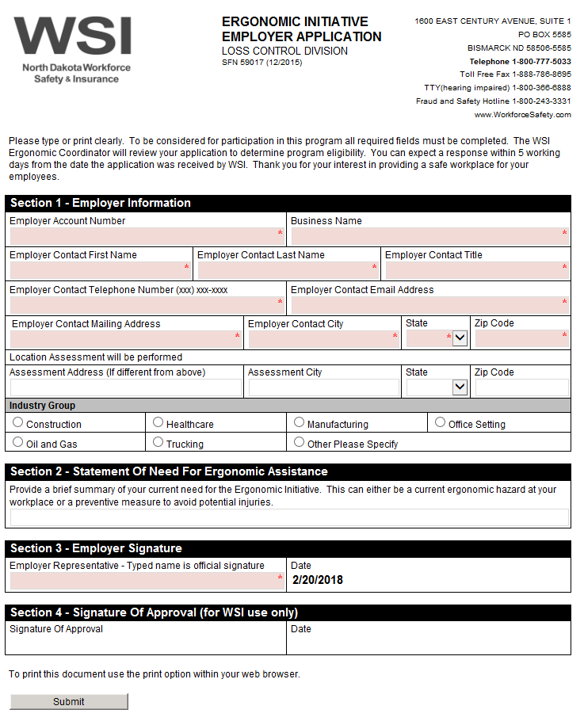
www.
workforcesafety.com

Slide 42
ERGONOMIC
GRANT PROGRAM
www.
workforcesafety.com/employers/safetygrants

Slide 43
Ergonomic Grant Program What Is It?
Grant program associated with the EI Program
Provides financial assistance to ND employers to assist with the purchase of ergonomic equipment

Slide 44
Ergonomic Grant Program Who is Eligible?
Employers who have participated in the Ergo Initiative Program
Active account that is in good standing with WSI for at least one year

Slide 45
Ergonomic Grant Program Financial Assistance
Award amount is based on std. premium for the last completed premium year
3:1 match
WSI contributing 75%, up to the maximum award amount

Slide 46
Ergonomic Grant Program Grant Awards
Premium Size
$250 - $5,000
$5,001 - $20,000
$20,001 - $50,000
$50,001 - $150,000
$150,001 - $300,000
$300,001 & above
Grant Award
$5,000
$10,000
$15,000
$20,000
$30,000
$50,000

Slide 47
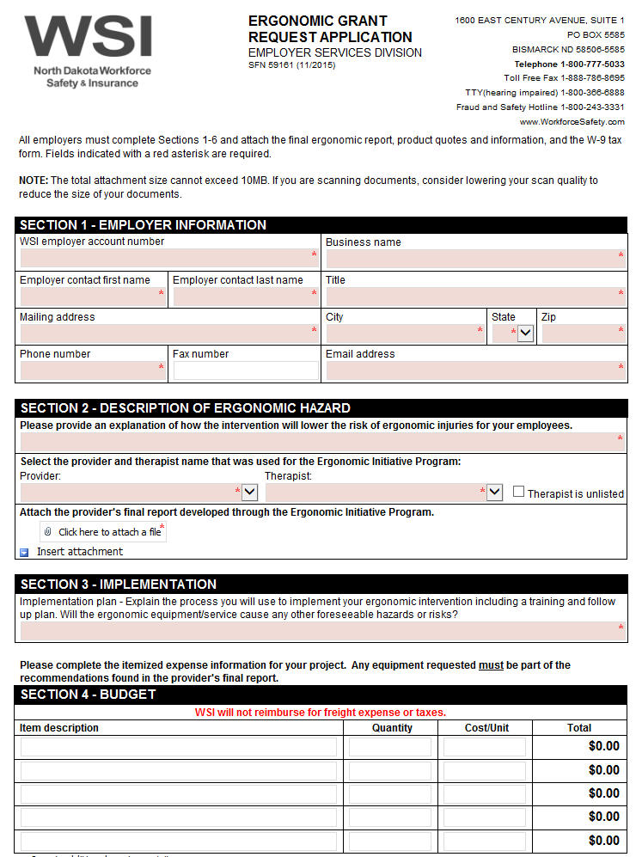
www.
workforcesafety.com

Slide 48
ERGONOMIC
INITIATIVE/
GRANT
PROGRAM
Randy Wegge
LC Program Specialist
Phone: 701-328-6006
Email: rwegge@nd.gov
www.
workforcesafety.com/employers/safetygrants

Slide 49
QUESTIONS
www.
workforcesafety.com/employers/safetygrants

