Slide 1
Infection Prevention and Communicable Diseases
Brenton Nesemeier, Field Epidemiologist
Laura Baum, EHP, Fargo Cass Public Health
Brad Schneider, EHP, Fargo Cass Public Health
February 20, 2019

Slide 2
Definition
Bloodborne Pathogen – A disease causing agent that is present in human blood or other bodily fluids that can be transmitted through contact. The most common bloodborne pathogens include human immunodeficiency virus (HIV) and viral hepatitis (HBV or HCV)

Slide 3
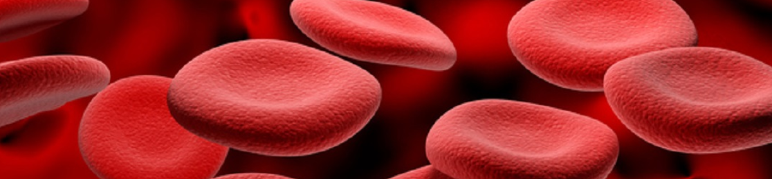
Bloodborne Pathogens

Slide 4
Introduction to Bloodborne Pathogens
HIV
Hepatitis B
Hepatitis C

Slide 5

HIV
Infectious Agent
  Virus
Reservoir
  Blood
  Other Body Fluids
Transmission occurs by exposure to infected blood through
  Needlestick/Use of Needles
  Sexual contact
  Perinatal/breastfeeding
Susceptible Host
  Humans
Notes:
Body fluids-semen, vaginal fluid or breast milk.

Slide 6

How is HIV NOT transmitted?
HIV is not transmitted through casual contact or exposure of intact skin to infected fluids.

Slide 7
HIV– ND Data

Slide 8

Viral Hepatitis
  Most common types are A, B and C in the United States and North Dakota; others include D and E
  Leading cause of liver cancer and most common reason for liver transplantation
  Many do not know that they are infected with hepatitis

Slide 9
Symptoms of Hepatitis
Not all new infections are symptomatic
Symptoms of hepatitis A, B and C are similar if not the same
  Jaundice
  Elevated liver enzymes
  Fatigue
  Abdominal Pain
  Loss of appetite
  Nausea
  Dark urine
  Fever
  Joint pain

Slide 10

Hepatitis B
Transmission
  Sexual transmission
  Injection drug use – Sharing needles (also includes tattoos and piercings)
  Infected mother to her baby at birth

Slide 11
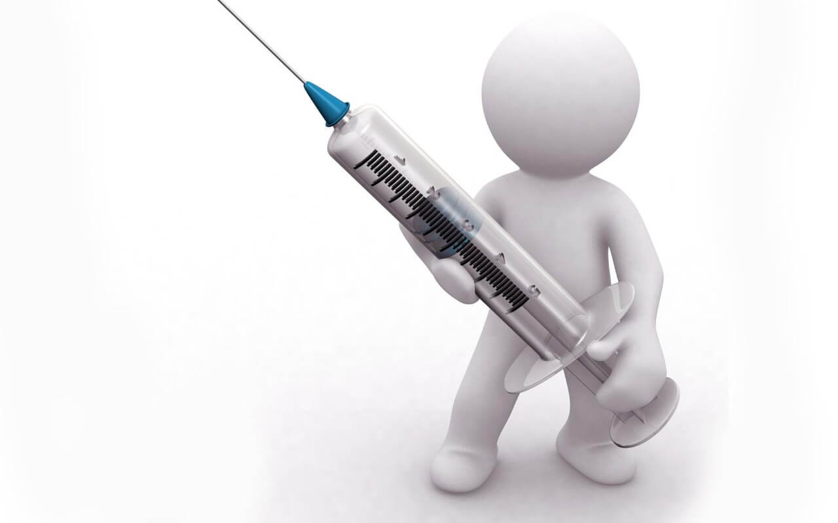
Hepatitis B
Prevention
  Get vaccinated
  Prevent blood and other bodily fluids from entering the body
  Use barriers for sex
  Do not share needles or other equipment that may have blood on them

Slide 12
Hepatitis B – ND Data
Hepatitis B case count and rate per 100,000, 2013-2017, North Dakota

Slide 13
Hepatitis C
HCV Epidemiology
  Nearly 3% of worldwide population has chronic HCV infection
    Most common bloodborne infection in the United States
  Up to 75% unaware of their infection
  3.2 million people living with HCV in the United States
  Infection is most prevalent among those born during the baby boomer generation (1945-1965)

Slide 14
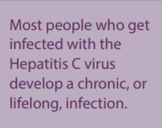
Average incubation period – 6 to 9 weeks
  Range 2 weeks to 6 months
Acute illness
  80% of people are asymptomatic
Chronic infection
  55-85% of infected people
Leading indication of liver transplant in the United States
Hepatitis C

Slide 15
Risk Groups for Hepatitis C
  Injection-drug users
  Recipients of clotting factors made before 1987
  Hemodialysis patients
  Recipients of blood and/or solid organs donated before 1992
  People with undiagnosed liver problems
  Infants born to HCV infected mothers
  People who have sex with multiple partners
  People who have sex with a HCV infected steady partner
Hepatitis C

Slide 16
Prevention
  Avoid blood exposures
  Do not share needles or equipment used for injecting drugs
  Use barriers and lubricants
  Cover open cuts/wounds
  Use universal precautions
  Don’t share personal items that may contain blood
  Proper sterilization of instruments and tools used for tattooing and piercing
Hepatitis C

Slide 17
Hepatitis C – ND Data
Hepatitis C case count and rate per 100,000, 2013-2017, North Dakota

Slide 18
Contaminated Hands
Contaminated Skin
How does
Transmission
Occur?
Contaminated environmental services

Slide 19
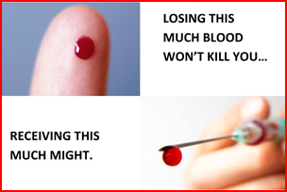
Employees who are exposed to blood or other infectious materials:
STAY CALM-If you have come in contact with blood or other body fluids, you have been involved in an exposure incident.
WASH exposed area with soap and water.
FLUSH splashes to nose, mouth, or skin with water for at least 15 minutes.
IRRIGATE eyes, cuts, or wounds with water or saline.
REPORT the exposure to your supervisor.
Notes:
No scientific evidence shows that using antiseptics or squeezing the wound will reduce the risk of transmission of a blood borne pathogen.
Using a caustic agent such as bleach is not recommended.

Slide 20
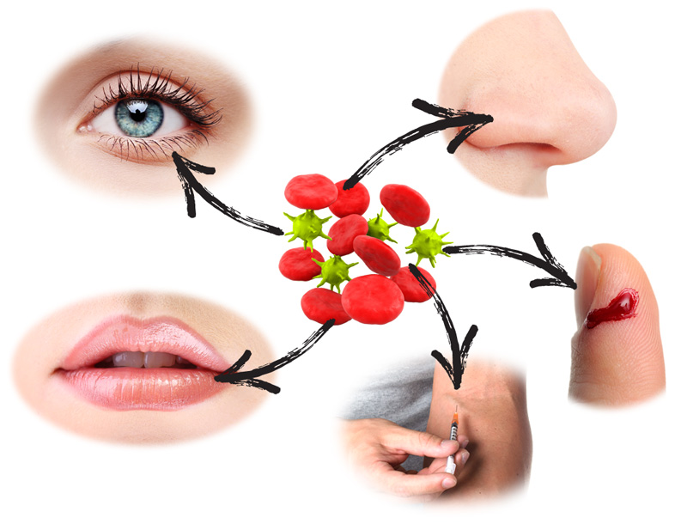
After the Exposure:
Document routes of exposure and how the exposure occurred. HOW, WHEN, WHERE and WHO.
Your employer should have in place a system for reporting exposures in order to quickly assist you.
Seek Medical attention. A medical professional will provide you with appropriate testing, treatment and education/counseling.
https://www.cdc.gov/niosh/topics/bbp/emergnedl.html
* Exposure to a communicable disease without proper PPE should also be reported.
Notes:
Medical provider will determine risk of exposure and potential for infection-This may involve testing your blood and that of the source and offering appropriate post exposure treatment

Slide 21

Infection Prevention and Control
Personal Protective Equipment
Handwashing
Environmental Cleaning

Slide 22
Standard Precautions (Universal Precautions)
Standard precautions are to be used
The type of PPE used to complete a task should be selected according to the type of exposure to blood, bodily fluids, wounds, respiratory secretions, mucus membranes, etc. that may occur.
  More PPE is not necessarily better!
Masks, goggles, or face shields may be needed if there might be splashes, sprays, or other exposures to the eyes, nose and mouth.
Gowns may be needed to protect the wearer’s clothing from getting contaminated or soiled. Gowns can also protect from splashes or sprays.

Slide 23
Two Separate Processes
Cleaning: is the removal of foreign material (e.g., soil, and organic material) from objects and is normally accomplished using water with detergents or enzymatic products. Thorough cleaning is required before disinfection and sterilization because inorganic and organic materials that remain on the surfaces of instruments interfere with the effectiveness of these processes. Also, if soiled materials dry onto the instruments, the removal process becomes more difficult and the disinfection or sterilization process less effective or ineffective.
Disinfection: is the process that eliminates many or all pathogenic microorganisms, with the exception of bacterial spores, from inanimate objects.

Slide 24
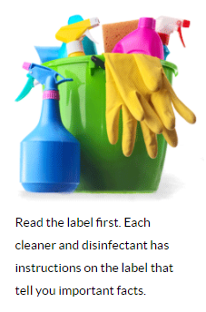
How Products Should be Used
What surface product can be used on
How to apply the product to a surface
How long to leave product on a surface (contact time)
If dilution or rinsing is required
Precautions to take when using and applying product

Slide 25
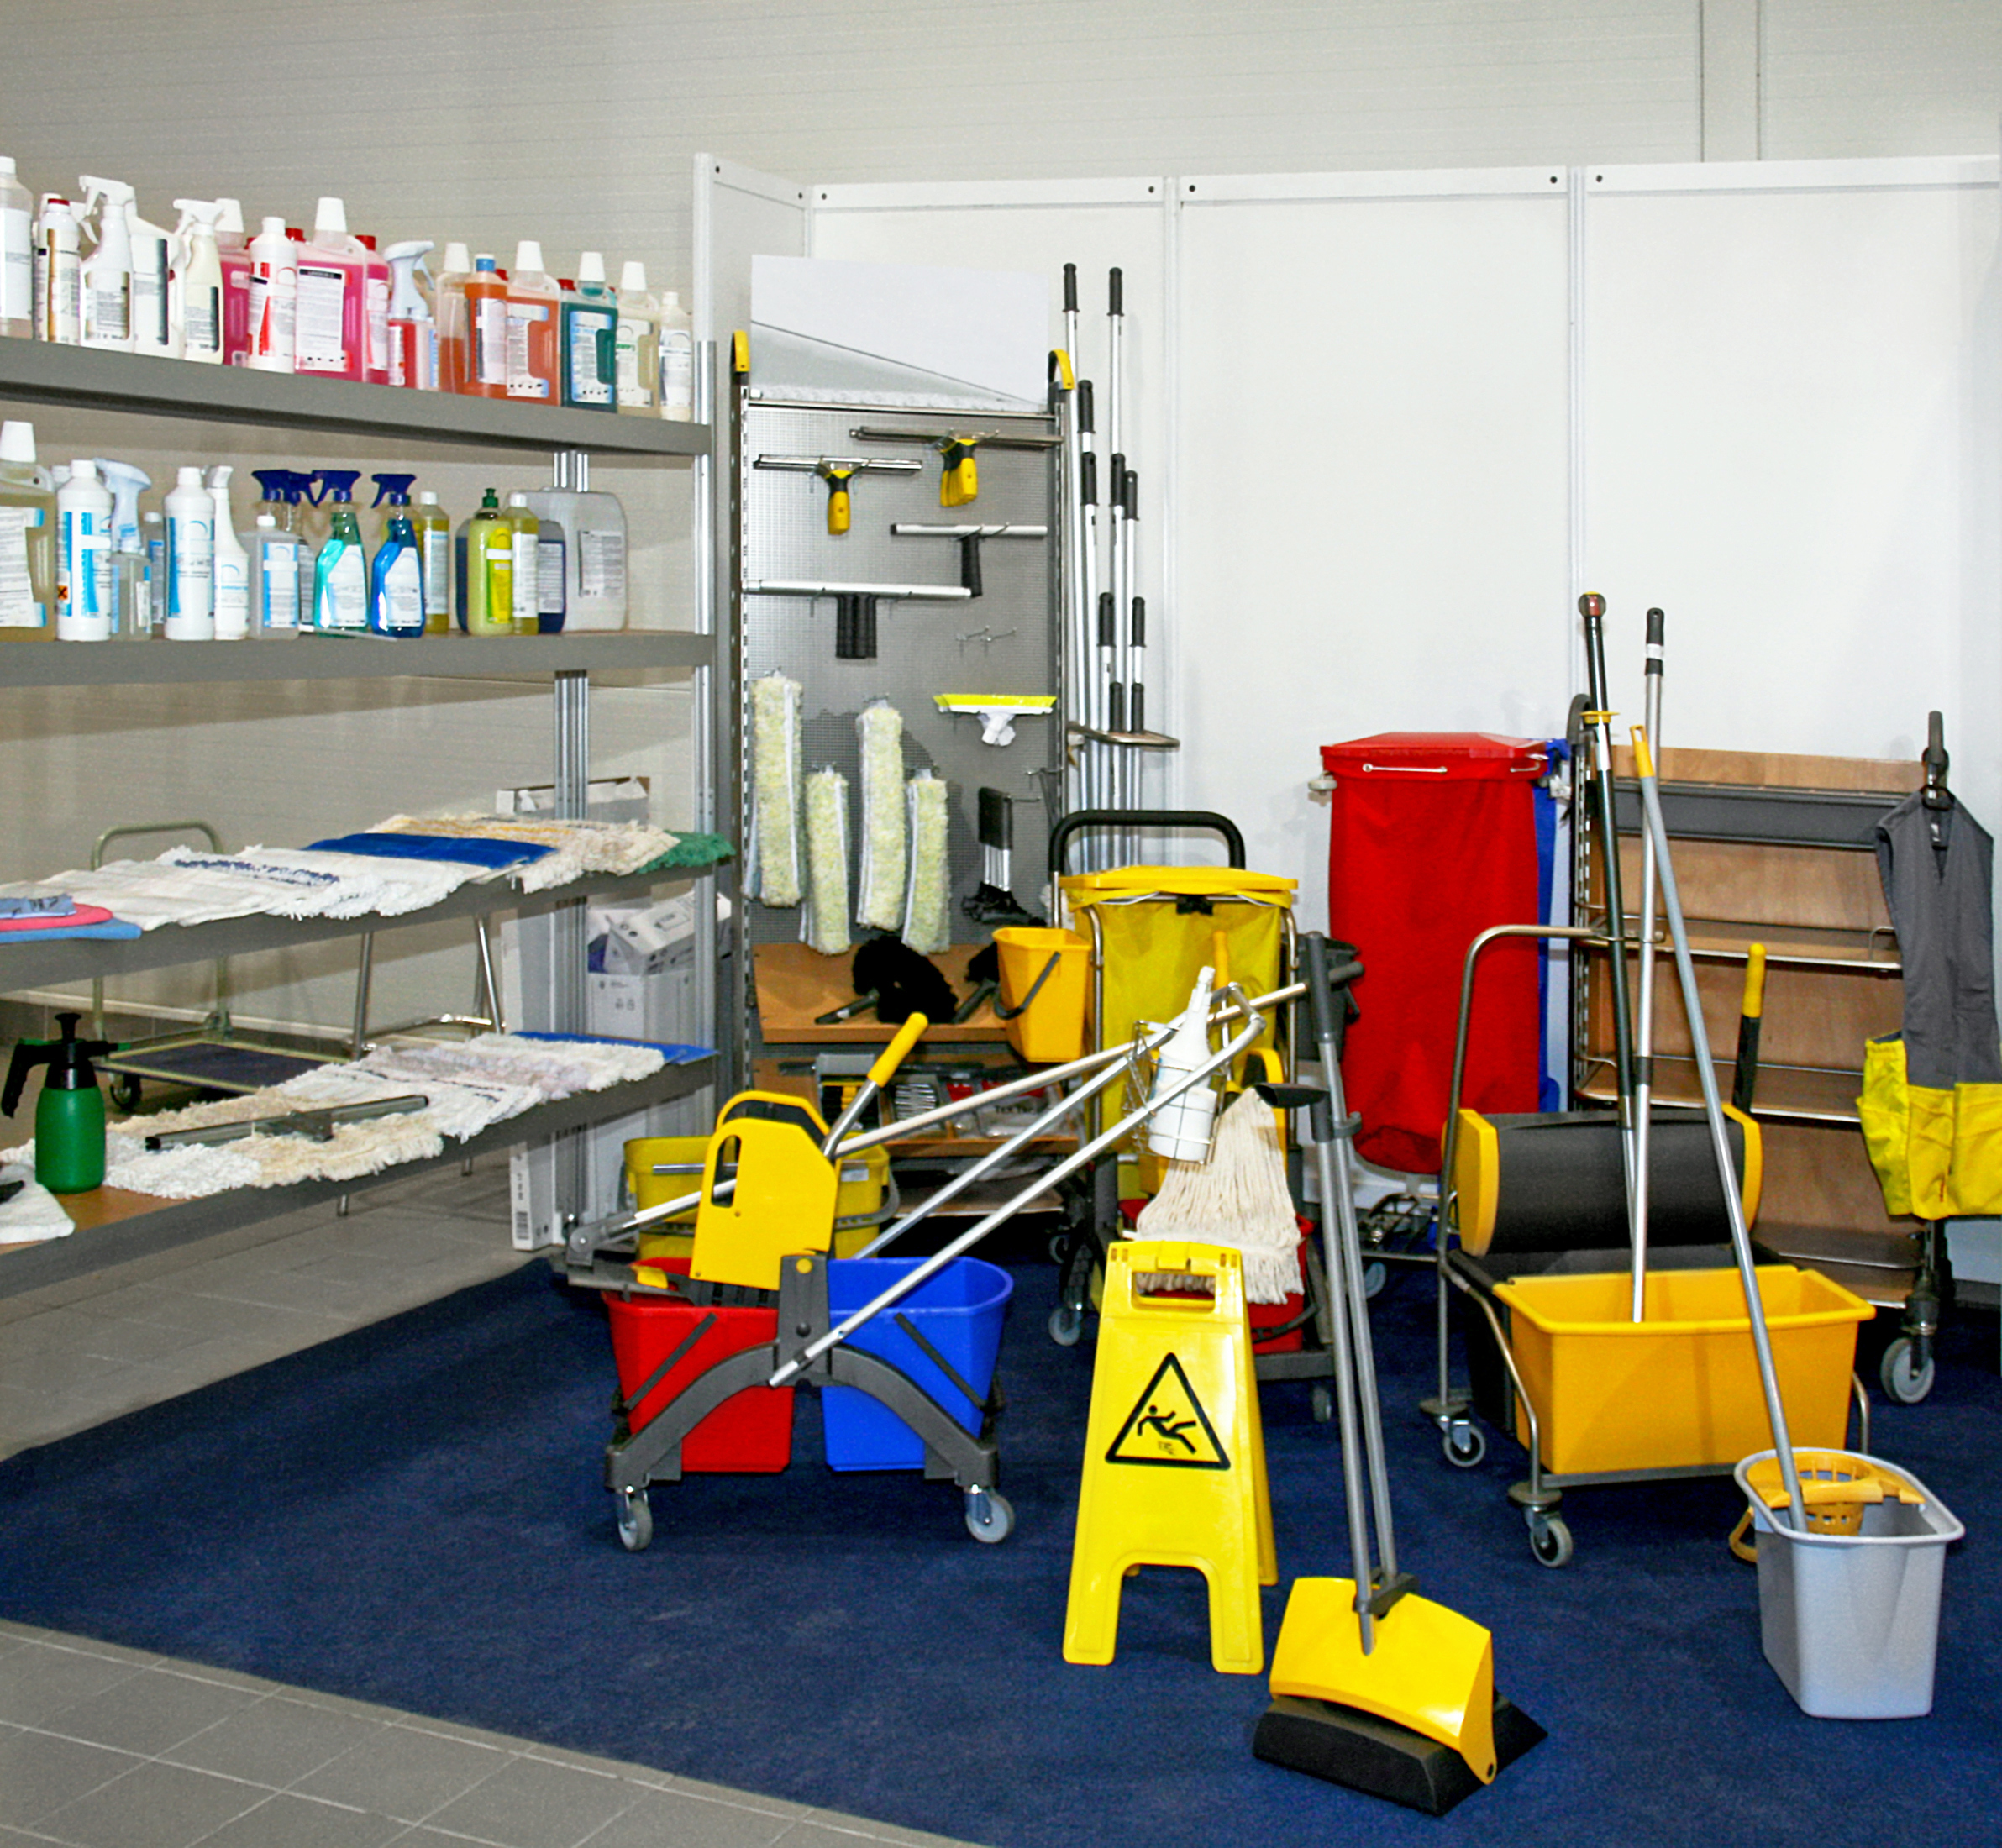
Each disinfectant has instructions on the label that tell you important facts:
Which organisms it is effective against
How to apply the product to a surface
Contact or dwell time indicates how long the surface must remain wet with disinfectant and is key to the product claims, ADHERE TO IT!
If the surface needs to be cleaned first and rinsed after using
If the disinfectant is safe for the surface
Whether the product requires dilution with water before use
Precautions you should take when applying the product, such as wearing gloves or aprons or making sure you have good ventilation during application

Slide 26
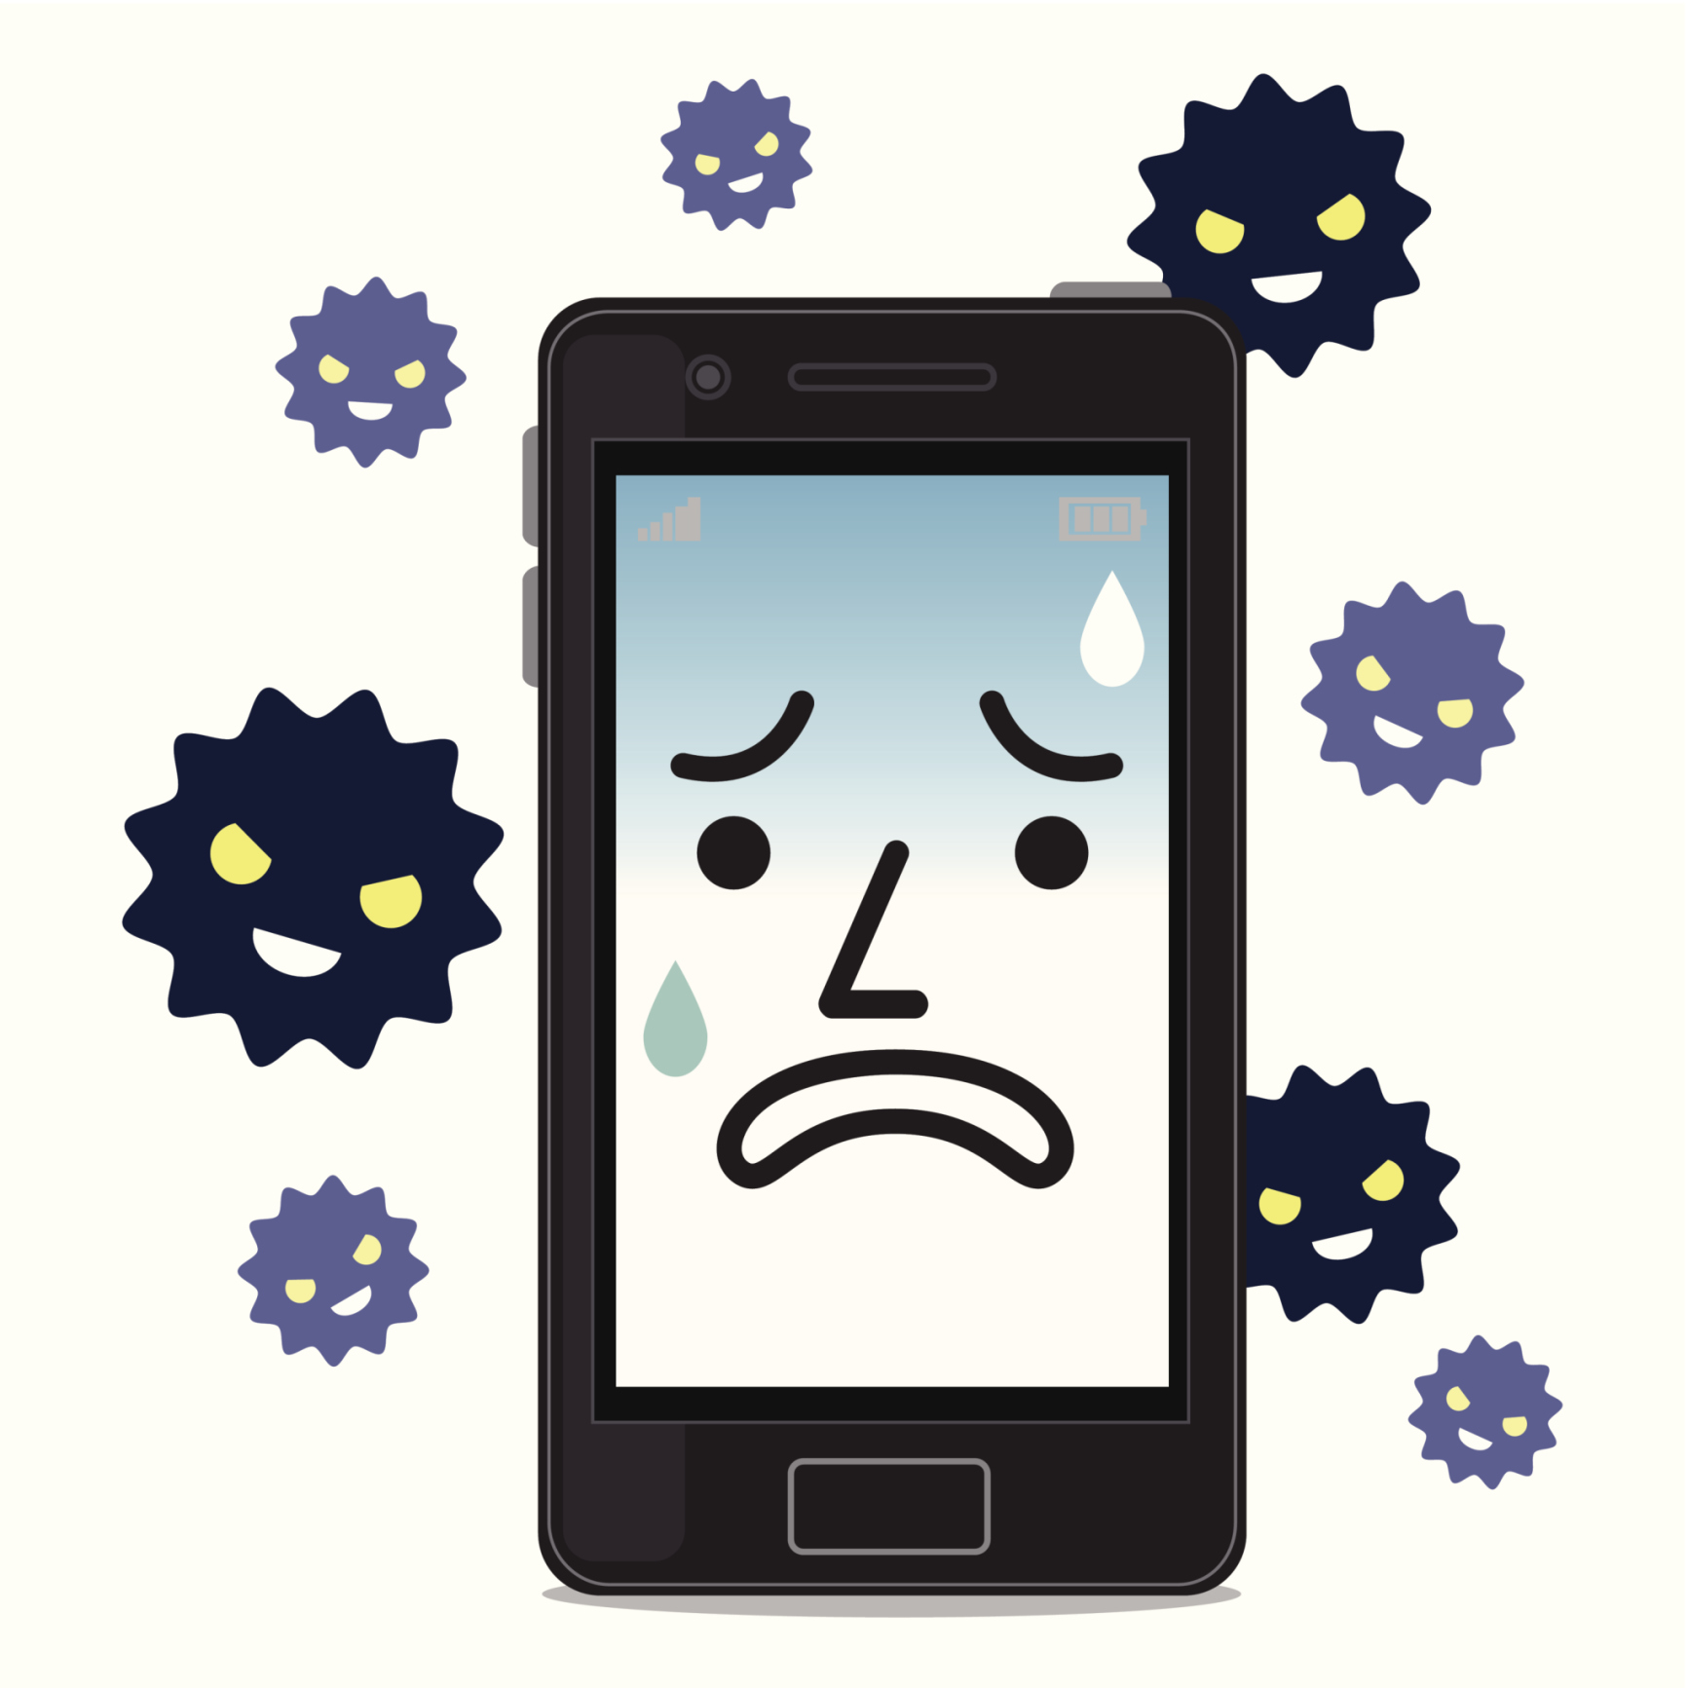
Have you cleaned your screen lately?
The growth of touchscreens and tablets in healthcare
Notes:
1The Journal of Bone and Surgery. 2015. Investigation of cell phones as a potential source of bacterial contamination in the operating room. Retrieved 7/25/2016 from http://www.ncbi.nlm.nih.gov/pubmed/25653323. 2Epocrates Mobile
Trends Report, 2014. Retrieved 7/25/2016 from http://www.epocrates.com/oldsite/statistics/2013%20Epocrates%20Mobile%20Trends%20Report_FINAL.pdf 3The Journal of Occupational and Environmental Hygiene. 2015. Mobile Phones
as a Potential Vehicle of Infection in a Hospital Setting, Retrieved 7/25/2016 from http://www.ncbi.nlm.nih.gov/pubmed/26083898 4American Journal of Infection Control. 2015. Use of portable electronic devices in a hospital setting and
their potential for bacterial colonization, 2015 Retrieved 7/25/2016 from http://www.ncbi.nlm.nih.gov/pubmed/25557772. 5Forrester. 2013. Global Business and Consumer Tablet Forecast Update, Retrieved 7/25/2016 from
https://www.forrester.com/report/Global+Business+And+Consumer+Tablet+Forecast+Update+2013+To+2017/-/E-RES97182

Slide 27
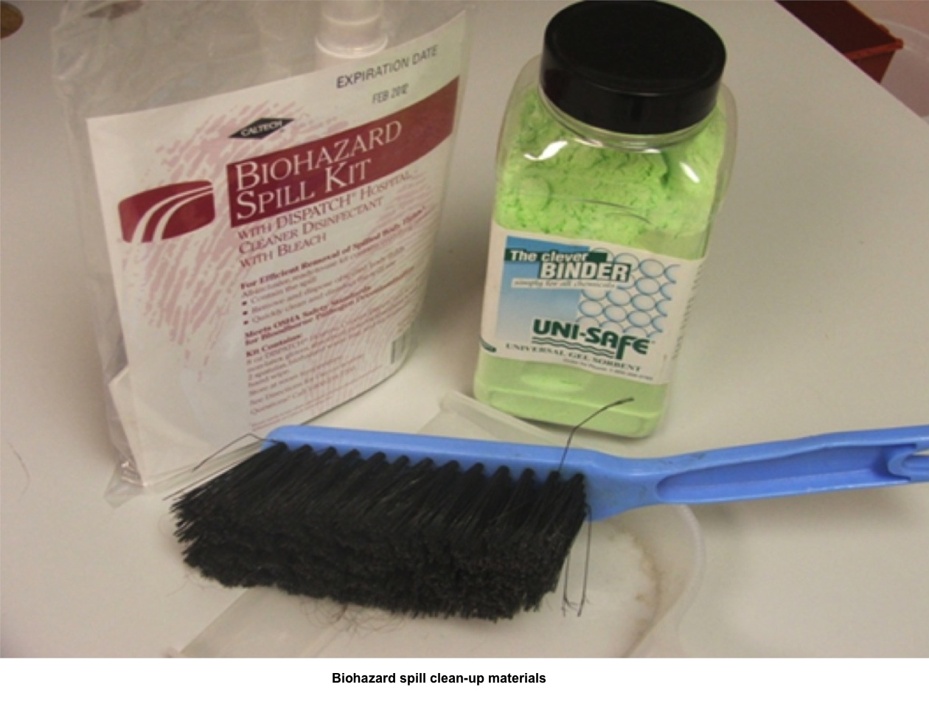
Good Housekeeping/
Biohazard spill kit:
Decontaminate work surfaces when the surface has been contaminated.
Decontaminate equipment after use.
Gloves are not a substitute for hand hygiene, so make sure to perform hand hygiene after removing gloves.
For blood and body fluid spill;
Cover with paper towels or other absorbent material (ex. kitty litter) and saturate with disinfectant.
Allow contact time of at least 20 minutes before manually cleaning.
Remember to wear personal protective equipment during this process.
Dispose of PPE and contaminated laundry properly in designated areas or containers.
Notes:
All staff should know where the kits are, how to properly use and having yearly training and competency.

Slide 28
Personal Protective Equipment (PPE)
Protective clothing, gloves, face shields, goggles, masks, respirators, or other equipment to prevent injury or the spread of infectious diseases.

Slide 29
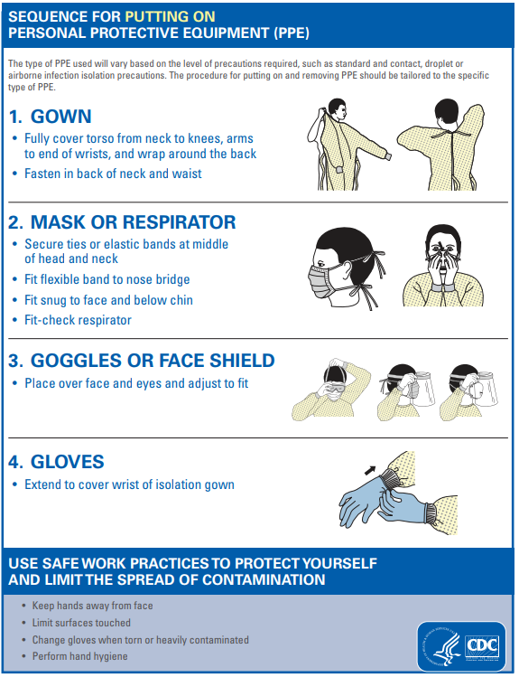
Sequence for Donning PPE:
Hand Hygiene
Gown/apron
Surgical or particulate mask (N95)
Protective Eye wear
Gloves
Notes:
Before entering room, use the appropriate PPE needed for designated task and potential for exposure.

Slide 30
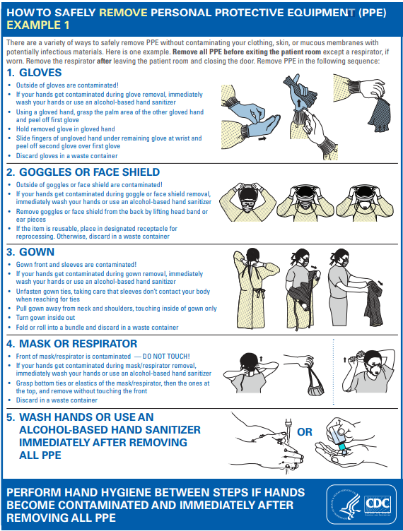
Sequence for Removing PPE:
Gloves
Hand hygiene
Face shields or goggles
Gown
Mask or respirator
Hand hygiene
Notes:
Remove at doorway. If airborne precautions, mask is removed immediately outside of room. Do not touch front of mask.

Slide 31

Gloves
Must be worn if wearer or patient/client has cuts, open wounds/sores, blisters, or visibly issues with skin integrity
Must be worn for procedures and other tasks when contact with blood, bodily fluid, mucous membranes, or potentially infectious material may occur
Must be changed between tasks (dirty to clean) and hands should never be washed with gloves on
If gloves get soiled, they must be changed.
Gloves can be a mode of transmission when not removed immediately after a task is performed.
Perform hand hygiene immediately after gloves are removed.

Slide 32
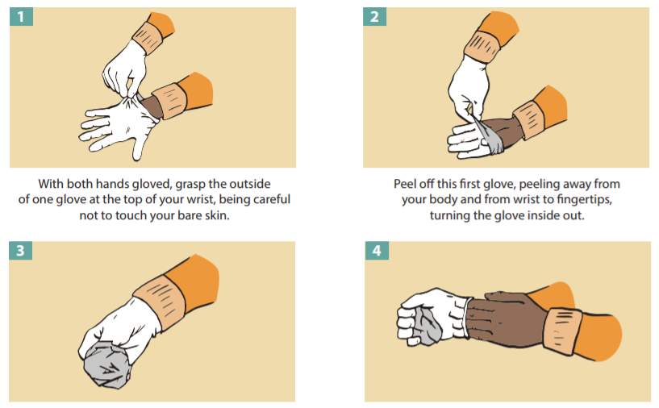
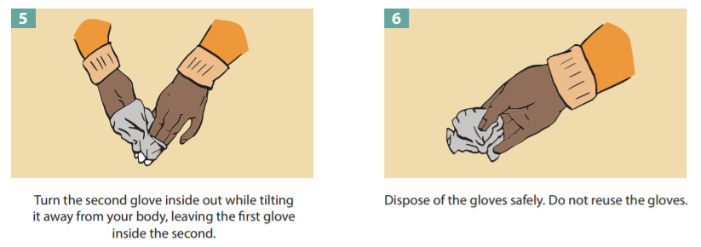

Slide 33
Gloves are NEVER a substitute for hand hygiene!
Hand hygiene must be performed before and after glove use.
Gloves should be removed and hand hygiene performed when moving from one task to another.
  Example: need to get more supplies once you started a procedure
REMEMBER to perform hand hygiene when you are done with your task before you re-glove!

Slide 34
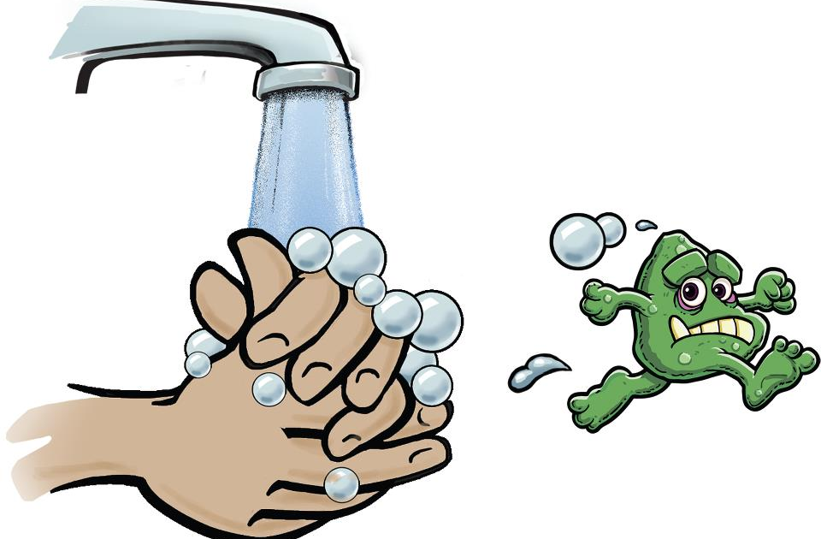
Hand Hygiene
#1 defense to prevent infection!

Slide 35
What’s the difference?
Handwashing
Hand Sanitizing
Mechanical removal of dirt, grime, microorganisms, etc.
Soap and water
Must be performed if hands are visibly soiled or contaminated with blood or bodily fluids!
Reduces the number of microorganisms on the surface of the skin
At least 60% alcohol
More effective for standard hand hygiene in healthcare settings

Slide 36

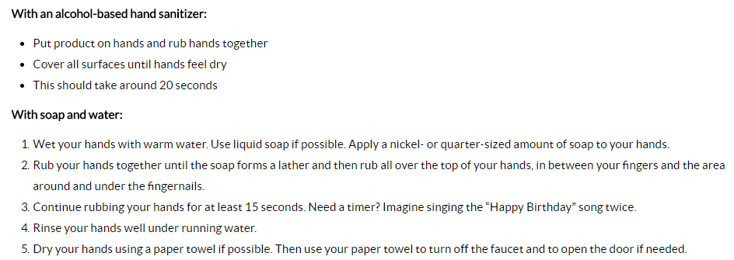
Hand Rub

Slide 37
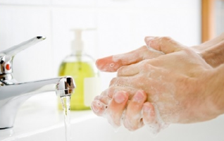
Handwashing

Slide 38
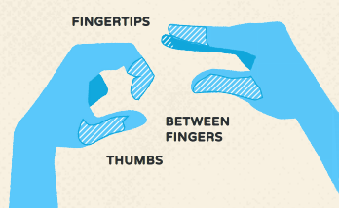

Areas Commonly Missed While Handwashing

Slide 39
Other Hand Hygiene Tips
Hands should be washed with soap and water if visibly dirty or have had contact with blood or bodily fluids.
Hands may need to be washed with soap and water after hand sanitizer has been used a number of times to remove product build-up.
Choose products that are compatible with each other and PPE such as gloves.
  Reduces interactions
  Skin integrity
  Always follow manufacturer’s instructions for use
  Don’t allow staff to use hand sanitizer brought from home
Never “top-off” bottles of soap or hand sanitizer. Doing so can introduce contamination and microorganism growth.
Monitor staff for proficiency

Slide 40
Dispose of infection waste materials
Safely dispose of infectious waste materials or contaminated items to protect those who handle them and prevent injury or spread of infection to the community.
Warning labels are required on containers of regulated waste containing blood and other infectious materials, and contaminated equipment.
Red bags or containers should be used that do not leak and are puncture and tear resistant. Sharps need to be disposed in sharps container.
Other regular disposable items should be placed in a covered container lined with a plastic bag. May be disposed of in the regular trash.
https://deq.nd.gov/WM/InfectiousWaste/

Slide 41
Needles and other Sharps
Single-use and disposable
Properly store to maintain sterility
  Keep from moisture and temperature extremes
  NEVER store anything under sinks (even cleaning supplies)
Dispose of in a puncture-proof sharps container
  Avoid accidental puncture by not manipulating in any way before disposal.
  Do not overfill the sharps container (3/4 full, time to replace)
  See the Department of Environmental Quality waste management program’s Guide to Understanding North Dakota’s Infectious Waste Regulations for information about proper disposal of sharps containers.

Slide 42
References
http://www.legis.nd.gov/information/acdata/pdf/32-02-01.pdf
https://www.cdc.gov/
http://professionals.electrology.com/pdf/Infection-Prevention-Standards.pdf
https://www.ndhealth.gov/disease/conference/PPTs/Hep_Disease101_Dec2015.pdf
https://www.ndhealth.gov/Disease/Documents/faqs/Shingles.pdf

Slide 43
Thank You!
Additional Questions?
Please contact me at:
bnesemeier@nd.gov or 701-241-1386

