Slide 1
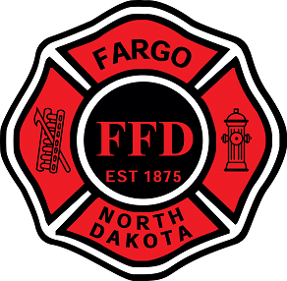
Fire Prevention for the Safety Professional
Notes:
Thank you for having me, my name is Dawn Stollenwerk and I am here to present “Fire Prevention for the Safety Professional”

Slide 2
Dawn Stollenwerk, Deputy Fire Marshal
Experience and Education
-Bachelor of Science in Sociology NDSU
-Started with Fargo Fire as a firefighter in 2009
-2014 promoted to the Fire Prevention Bureau
-Current duties
-120 hours of annual training across of variety of subjects
-Yearly training at National Fire Academy
-Certifications
Notes:
A little background about me, I have a BS in Sociology from NDSU
I started my career with the Fargo Fire Department as firefighter in 2009
In 2014 I was promoted to my current position.
Currently my duties include code enforcement, fire protection system plan review, new construction acceptance testing, public education, and fire investigation
In order to maintain certifications and meet department standards I need to attend a minimum of 120 hours of training per year in areas such as code enforcement, plan review, hazardous material, investigations, investigations, and public education.
I am certified by the International Code Council as a Certified Fire Marshal and Certified Building Official, I am Certified by the International Association of Arson Investigators as a Certified fire investigator

Slide 3
FIRE TRIANGLE
HEAT
OXYGEN
FUEL
Notes:
Fire requires fuel, heat, and oxygen.
Take one away...Adding water, reduces the heat, placing a lid on a pan, foam blanket on a flammable liquids fire….fire is extinguished
Preventing them from coming together (in sufficient quantities) and a fire is prevented

Slide 4
Four key principles for fire safety and prevention
Housekeeping and combustibles
Egress and access
Protection systems (active and passive)
Hazardous processes
Notes:
Strict monitoring of these 4 key principles will greatly reduce the likelihood of a fire. They also address many of the common fire code violations found during the fire inspection process. Here in Fargo we have adopted the 2018 IFC, if you are in a jurisdiction outside of Fargo you may be measured against a fire code other than the 2018 IFC. If you are unsure your local fire department or State Fire Marshals agency should be able to tell you the code they enforce and how to locate the code for reference.

Slide 5
Housekeeping
Combustibles:
-What is a combustible?
-Controlling combustibles will help reduce the likelihood of fire.
-Is it needed?
-Waste?
How are they stored?
-Neat and orderly?
-Proximity to heat producing appliances
Electrical:
-Extension cords
-Power-strips and mult-tap adapters
-Portable heaters
-Junction box covers, electrical panel blanks
-Storage clearances
Notes:
To put it simply good housekeeping acts as a great preventer of fire in and of itself. Important things to consider regarding housekeeping are combustibles...first very basic what it a combustible...anything that will burn. This is the fuel portion of the fire triangle. If we limit the presence of combustibles in a structure we immediately begin to control a fires potential for growth. Are we being thoughtful with our storage of combustibles are do we have random piles or storage throughout. What is the relation of combustibles to heat producing appliances, to the ceiling…..we will continue to talk about this as we progress through the presentation. How are we using electricity in our facilities, electricity may provide the heat portion of the fire triangle and is a source for common fire code violations.

Slide 6
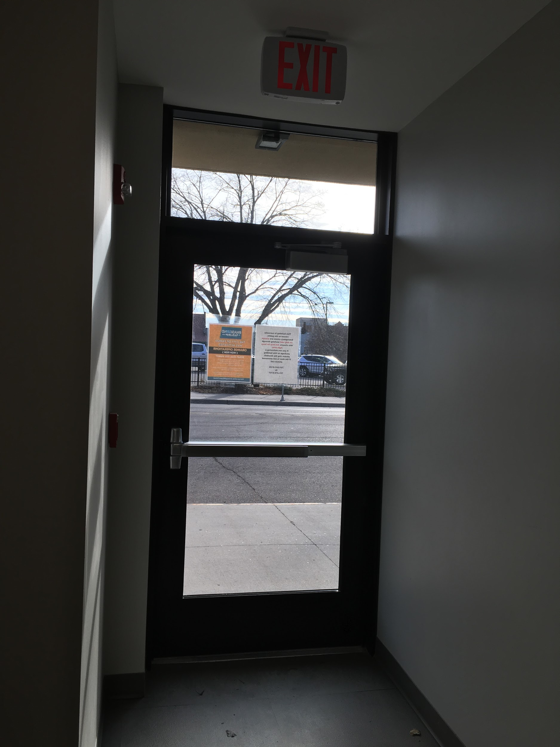
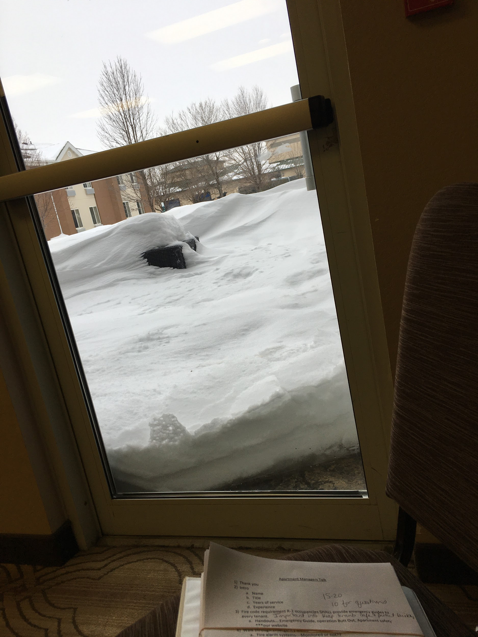
2) Egress
-Exit doors
-Working order
-Snow, ice, concrete?
-Unlocked and usable without special knowledge
-Clear paths
-No pinch points or obstructions
-Exit signs and emergency lighting
-Illumination of exit signs
-Inspection, testing and maintenance (ITM)
Notes:
Egress is the occupants way out and the FD way in!
Not just important for fire events, what if there is an active aggressor in those instances exiting is also extremely important in providing an escape route.
Make sure all paths are clear, void of trip hazards and pinch points. A path to an exit shall never be any narrower than the last exit door that leads you out side...36” door maintain 36” path.

Slide 7
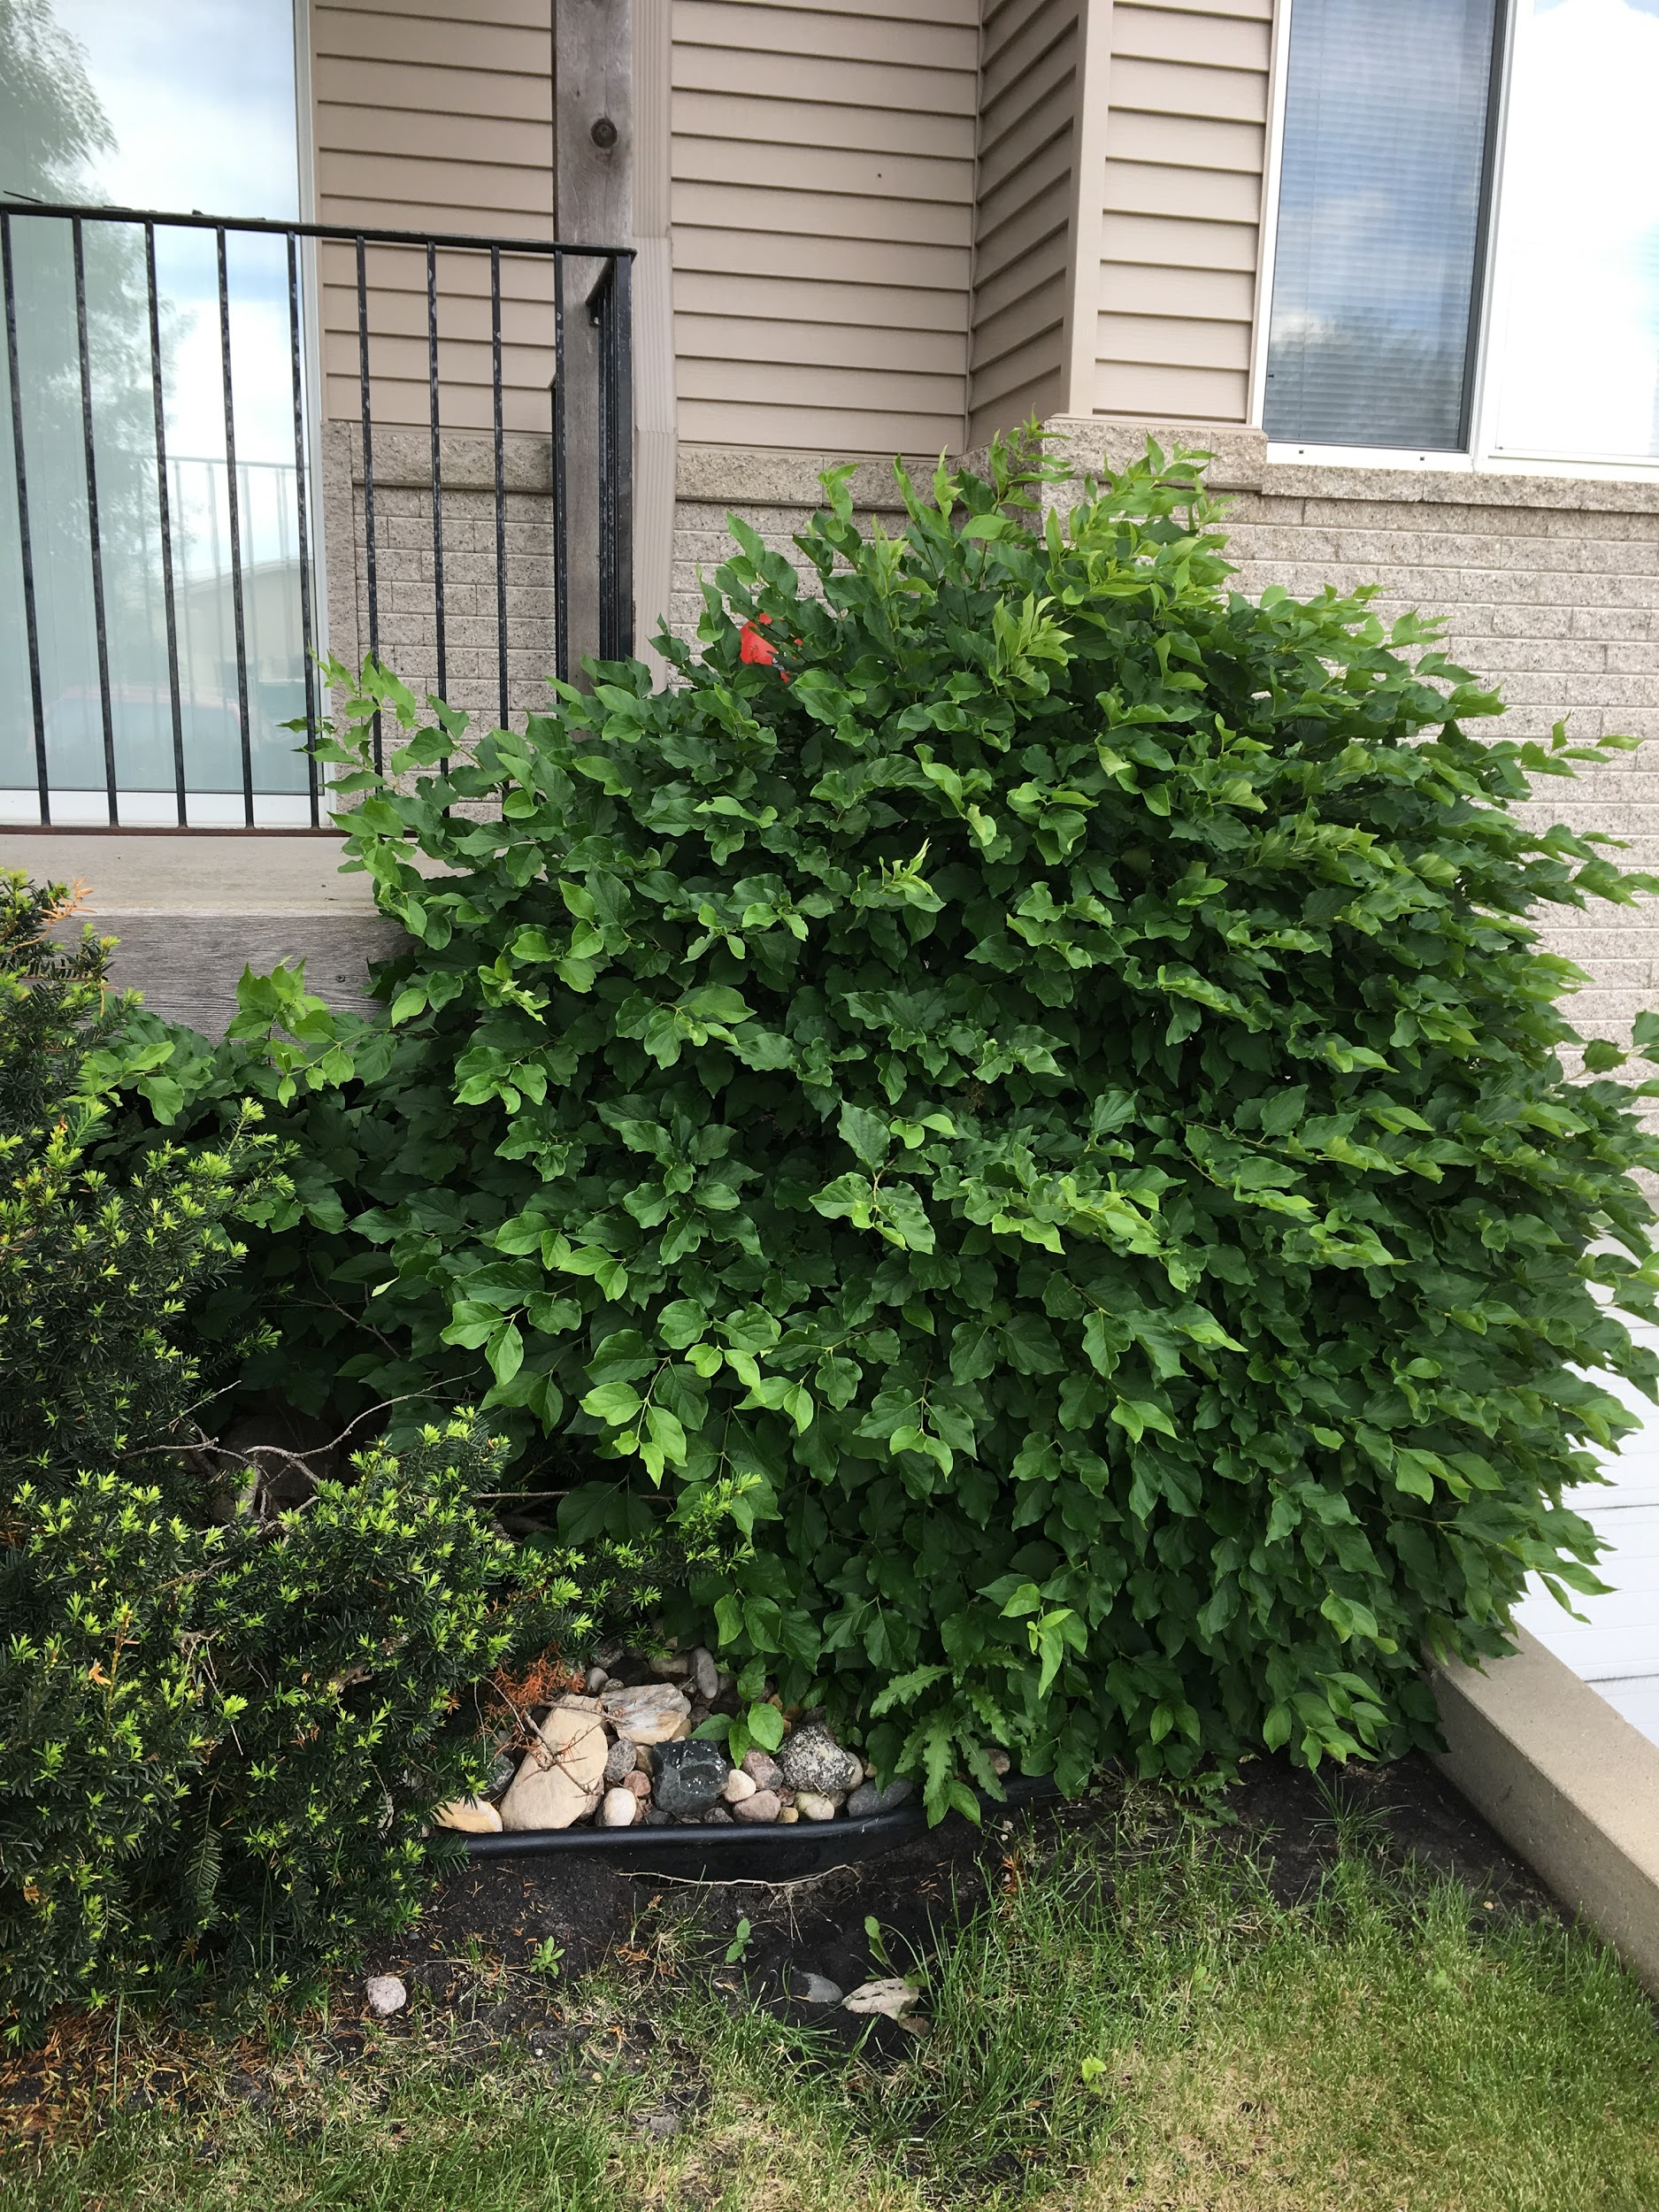
2) Access
-Premises identification
-Lock boxes may be required by the authority having jurisdiction.
-City of Fargo requirements
-Do you want to provide a lock box when it’s not required?
-Fire department connection and fire protection controls
Notes:
Can we find (customers) the building?

Slide 8
Questions?

Slide 9
3) Active Fire
Protection Systems
What are they?
How do they work?
control vs extinguish
Where are they found?
commercial and residential
Fire Suppression
Notes:
Active fire protection means that the system takes some sort of action, for example this may be in the form of fire suppression or detection and notification.
Right now we will be talking about fire suppression
Control versus extinguish some sprinkler systems are designed to extinguish the fire, most are designed to control the fire until FD arrival but do actually put out the fire.

Slide 10
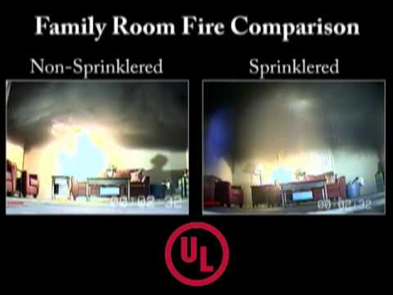

Slide 11
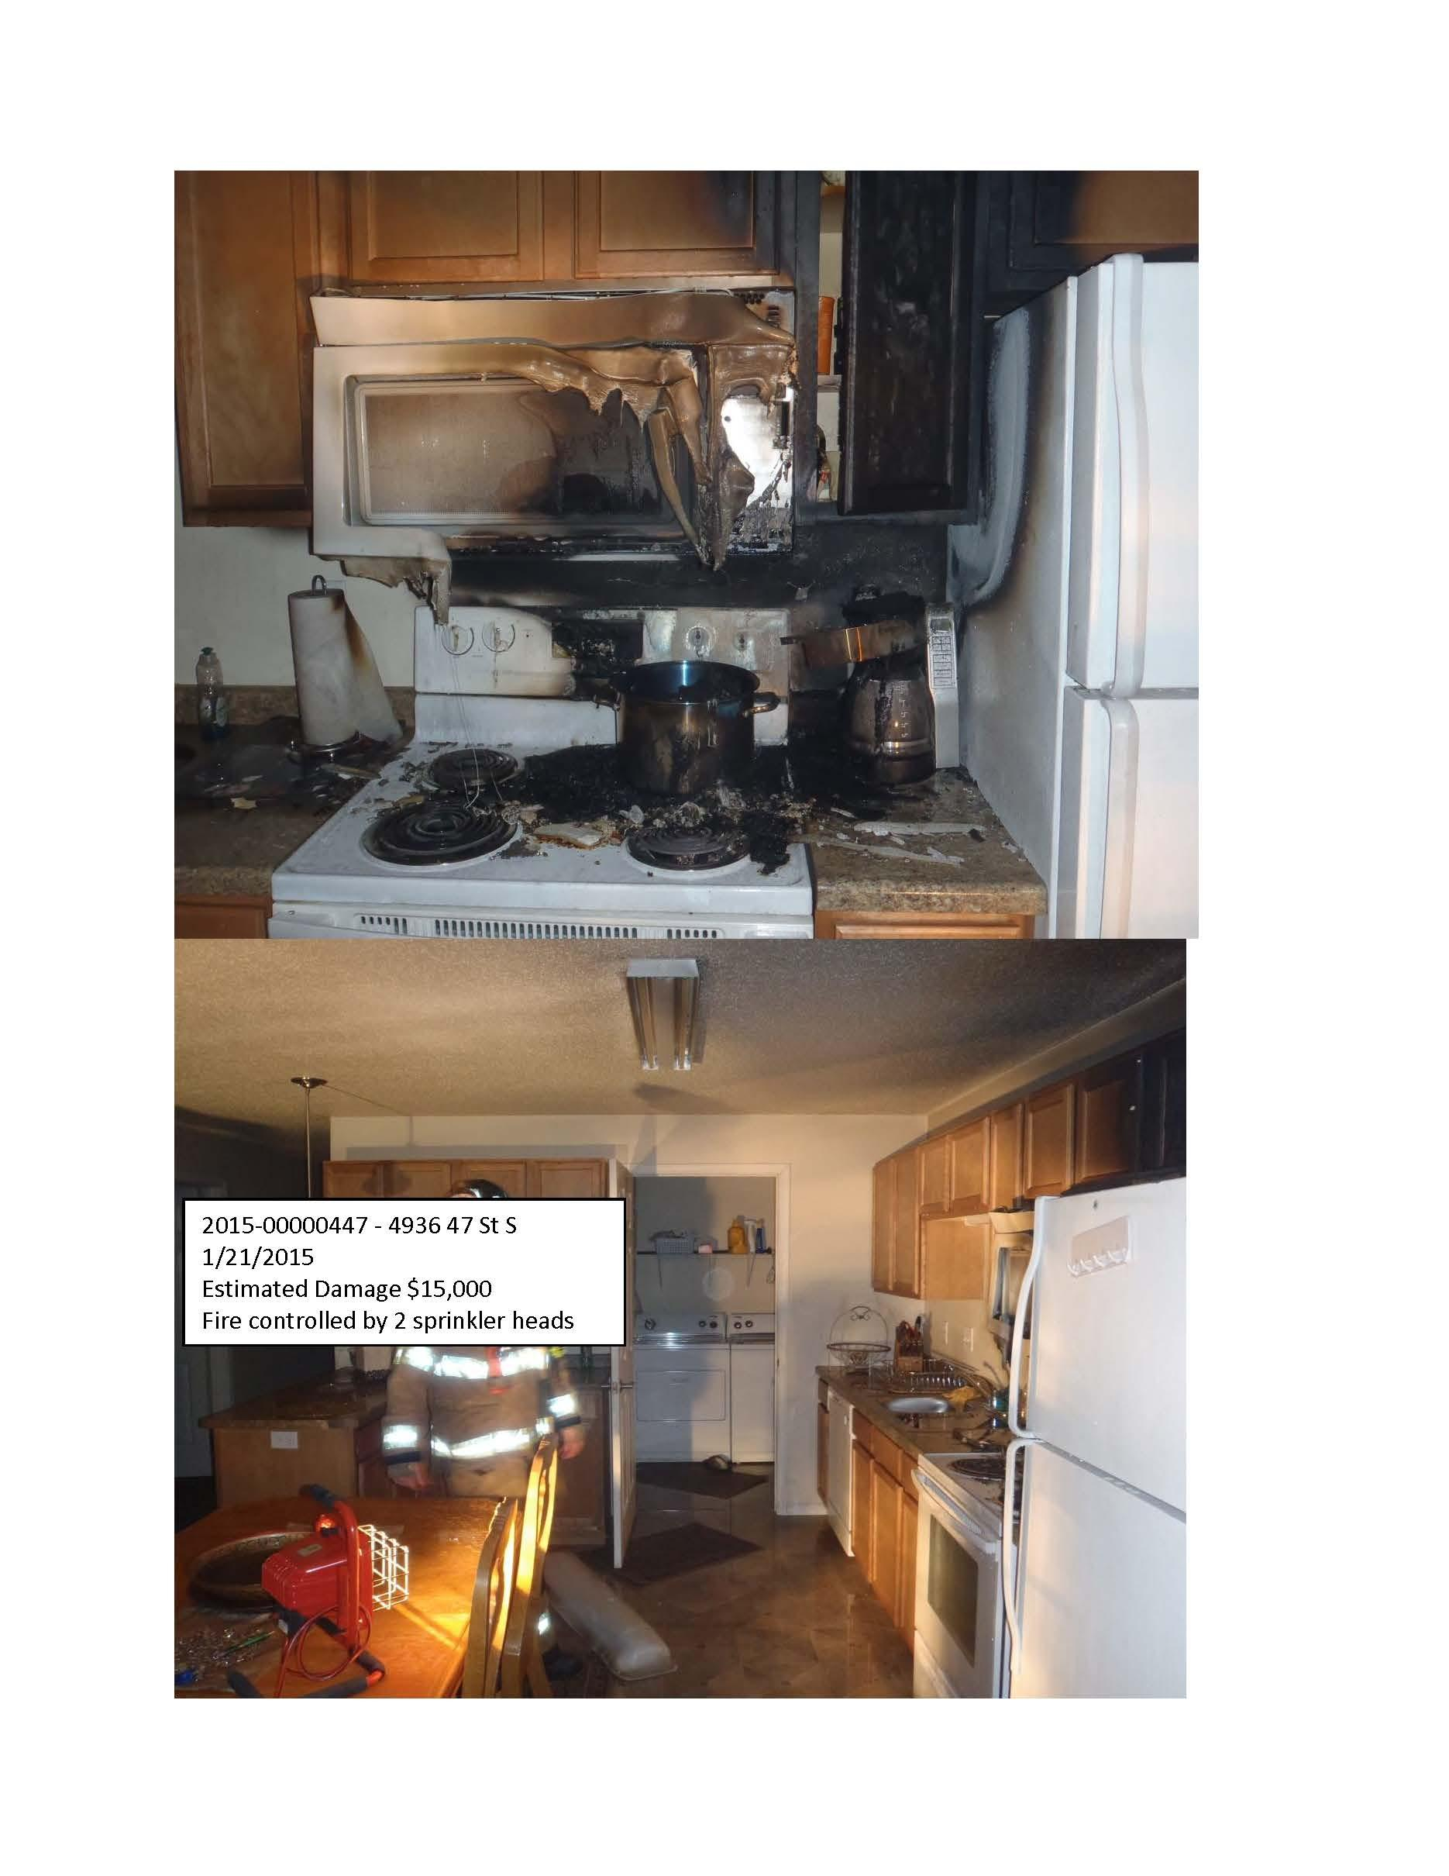
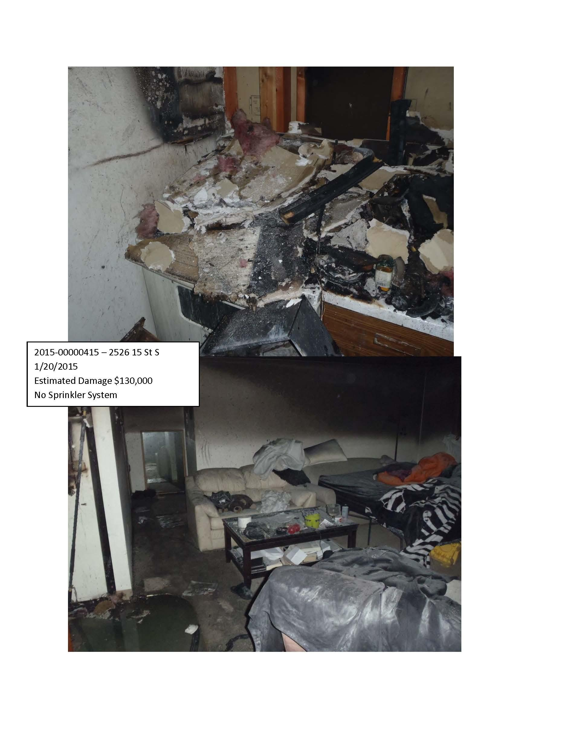
Notes:
The fire on the left was suppressed by a fire sprinkler system, notice that there is limited fire and smoke damage. On the right is another kitchen fire where there was not a fire sprinkler system present, note the increase level of fire and smoke damage.

Slide 12
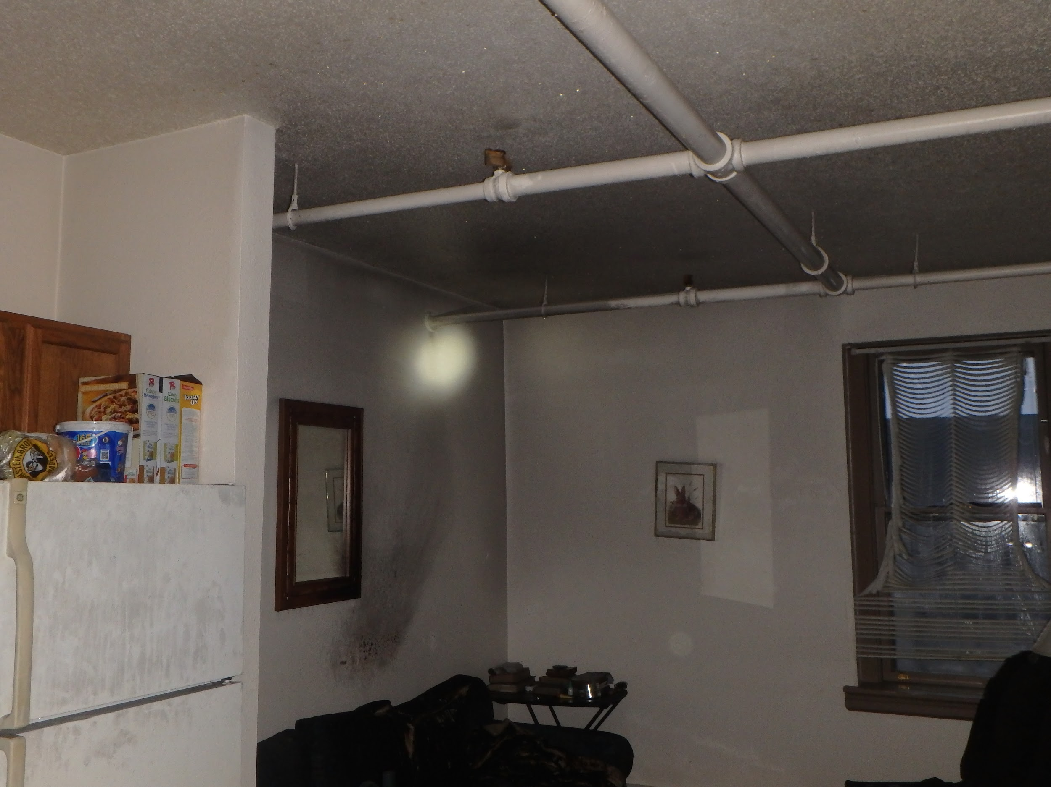
Notes:
These are examples of wet pipe sprinkler systems. Only the sprinkler heads closest to the fire activate to control the fire, most wet pipe sprinkler systems do not react like you see on TV with every sprinkler head in the building going off, nor do most systems activate by pulling a fire alarm pull box. Those system are rare and special hazard systems.
Other fire suppression systems may be a commercial kitchen hood suppression systems, these can function automatically or by a pull activation. There are also special hazard systems such as clean agent systems for electrinics.

Slide 13
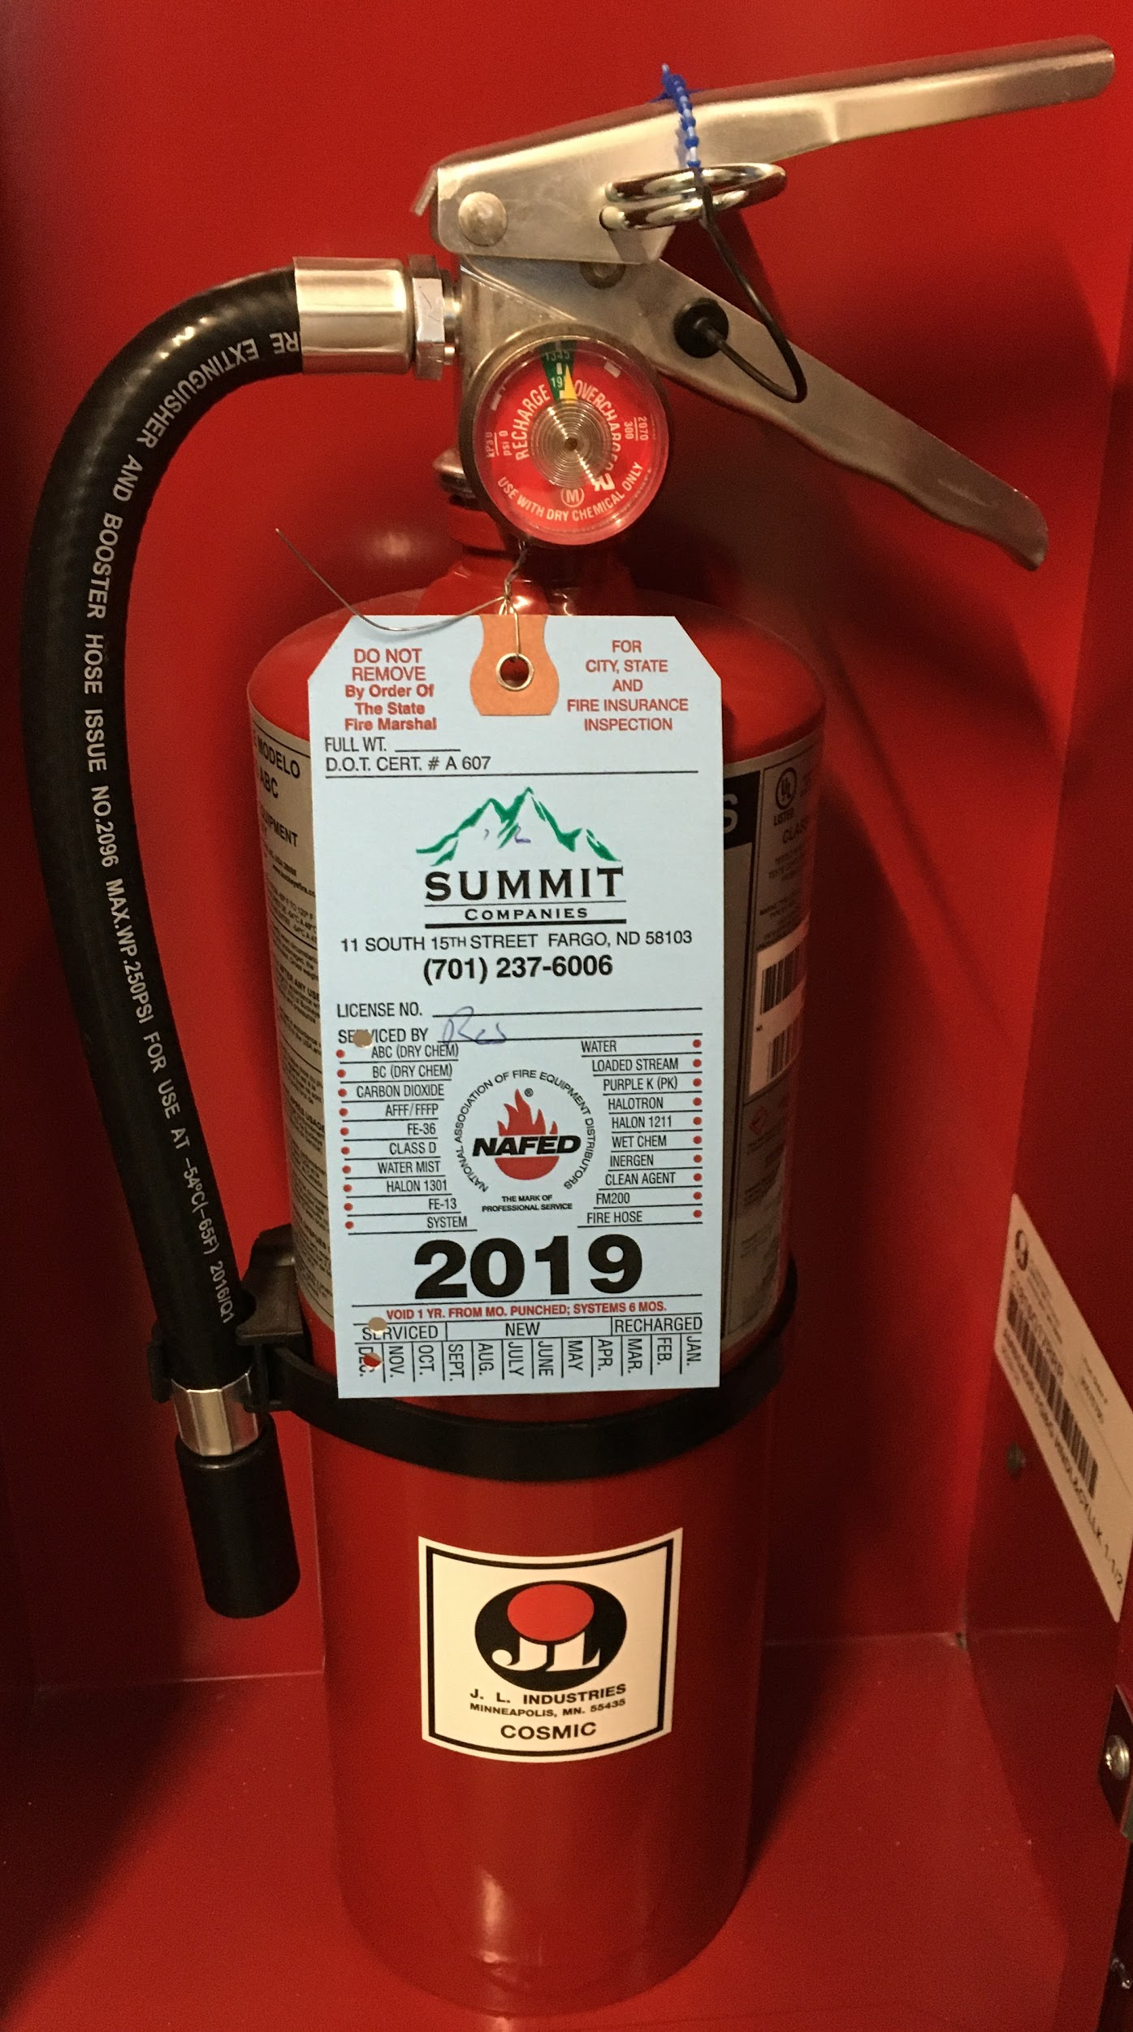
Fire Extinguishers
-Placement and type very by hazard.
-Basic requirements are 2A10BC extinguisher with 75’ of travel distance.
-To use:
Pull
Aim
Squeeze
Sweep
Notes:
A fire extinguisher is another form of active fire suppression.

Slide 14
3) Active Fire Protection Systems
Different types (local or monitored)
What does this mean?
What is in your facility?
Parts of the system
Fire Alarm
Notes:
Fire alarm systems are another form of active fire protection. A fire alarm system is designed to recognize there is a fire and notify occupants of the fire, allowing them time to evacuate.
Some fire alarms systems are monitored by a monitoring company which will contact the local fire department in the event of a fire alarm activation and some alarm systems report locally only. A local reporting system notifies the occupants only, it does not notify a monitoring company. The requirements for fire alarm monitoring may be different based on the code requirements at the time of system installation. It is important to know what is present in your facility, you or your staff may have to call 911 to report the fire alarm activation. Even if your system is monitored you can call 911, the more information we have while we are en route the better prepared we can be upon arrival

Slide 15
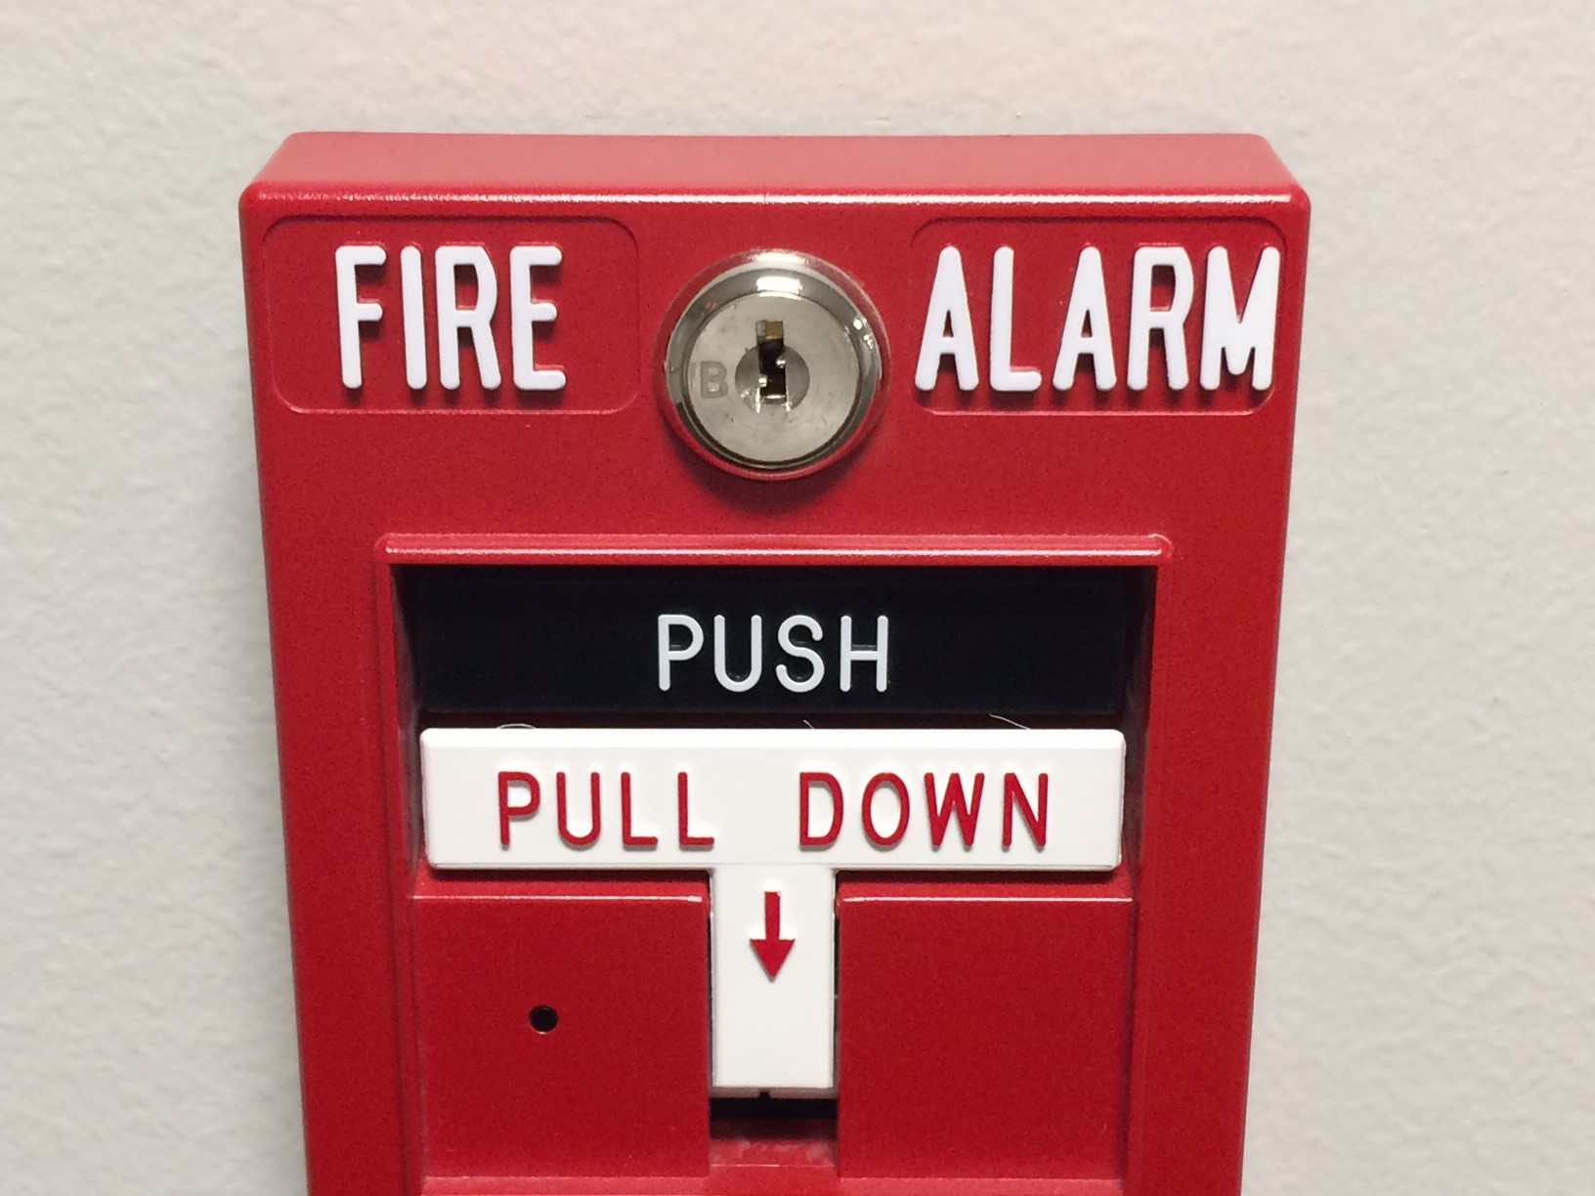
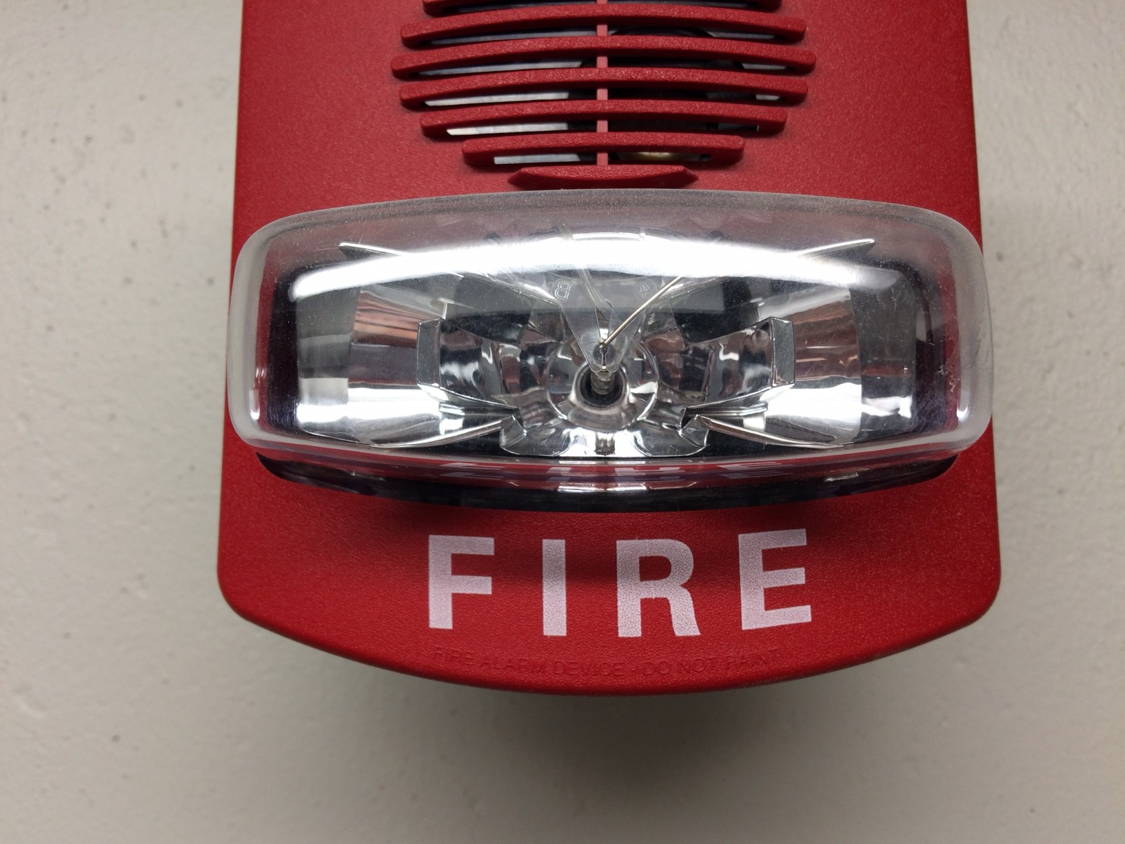
Fire Alarm System Parts
Common parts people may recognize: -Smoke detector
-Heat detector
-Pull Station
Other components:
-Fire suppression systems
-Fire alarm control panel
-Notification devices

Slide 16
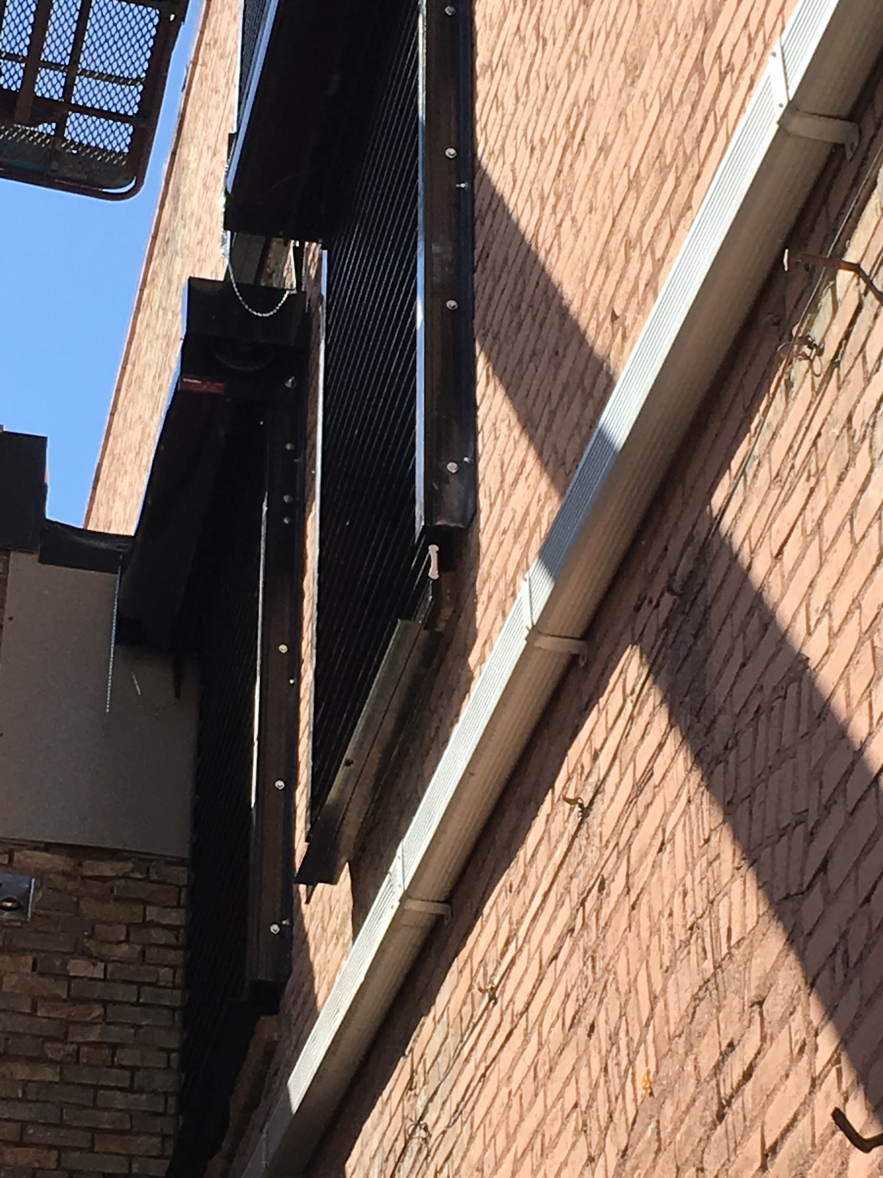
3) Passive Fire Protection
What are they?
Why are they important?
Fire barriers and opening protectives
Notes:
Passive fire protection means it is doing it’s job by just being there, like a fire wall.
A closed fire door is passive fire protection
A fire door that is open and designed to close as a result of heat or smoke would fall under active fire protection, but we will discuss them here.
These items are important because they create a barrier between you and the fire

Slide 17
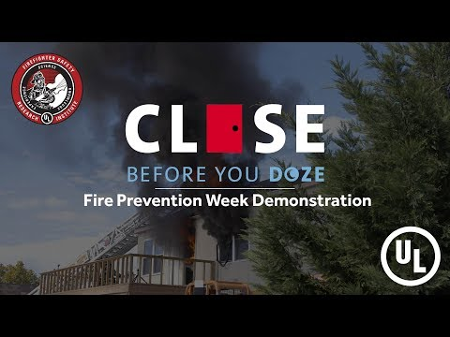
Compartmentilazation
Notes:
Perfect example of passive fire protection
Why is compartmentalization important?
Toxic gases (Carbon monoxide) are typically what kills people not the flames

Slide 18
Inspection, testing, maintenance (ITM) of active and passive fire protection components:
Fire protection systems, both active and passive, require some degree of ITM in accordance with the IFC, the regulatory standard they were installed under, and the manufacturer.
Examples: Fire Sprinkler, Alternative Automatic Fire-Extinguishing, Fire Alarm, Fire Doors
Annual, semi-annual, five year...
Why is it important?
But when they test the fire alarm system it interrupts my staff and customers.
Read the reports to know if your systems are meeting the maintenance standards.
Notes:
It is important that your systems are being maintained per the fire code and the standard of which they were installed under.
Some systems require testing and maintenance annually, some semi-annually, and some manufacturers require weekly tests, such as for fire pumps.
It is critical to know the systems in your facility and how to properly maintain them so that they are in working order if they are ever needed.
When you systems receive required testing maintenance be sure to read the reports your recieve and ask if you have any questions. There is much knowledge to be gained by reading these reports.

Slide 19
4) Hazardous processes
What is a hazardous process?
-These processes increase risk of harm and loss to your facilities, employees, and neighboring businesses.
-The fire department regulates these processes through the International Fire Code (IFC), currently 50 hazardous processes are specifically regulated in the 2018 IFC.
Examples
-Hot works
-Public assembly
-Flammable/combustible liquids storage and handling
-Compressed gasses
-Repair garages
-High piled storage
Are fire department permits required in order to conduct hazardous processes?
-Not all jurisdictions have adopted the operational permits of the IFC.
Notes:
Even if your authority having jurisdiction does not adopt the operational permits of the fire code they should still be able to provide guidance on code compliant practices regarding said processes.

Slide 20
In summary, being aware and taking action on the four key principles of fire prevention will help to protect your facilities and their occupants.

Slide 21
Questions?
Notes:
Next lets talk briefly about being prepared for a building evacuation and the things that you can do to be most successful during an evacuation.

Slide 22
Thank you!
Contact information
Dawn Stollenwerk
701.241.1311
dstollenwerk@fargond.gov

