Slide 1

Northern Region Association of Safety Professionals
Foodborne Illness and related information
Fargo Cass Public Health
November 21, 2018

Slide 2
Introduction
Grant Larson
Director of Environmental Health
Fargo Cass Public Health
glarson@FargoND.gov
701 241-1388

Slide 3
Agenda
  Cost of foodborne illness
  Foodborne Illness Risk Factors and Public Health Interventions
  FDA Food Code
  Employee Illness Reporting Agreement
  The Big 6 Reportable Illnesses
  FDA Food Code Requirements – Risk Factor/Interventions
  Good Retail Practices

Slide 4
Cost of foodborne illness
Cost of foodborne illness in the United States:
48 million illnesses per year
128,000 hospitalizations
3,000 deaths
$10-$83 billion – estimated suffering, reduced productivity, and medical costs

Slide 5
Foodborne Illness Risk Factors and Public Health Interventions
Epidemiological outbreak data repeatedly identify five major risk factors related to employee behaviors and preparation practices in retail and food service establishments as contributing to foodborne illness:
Improper holding temperatures
Inadequate cooking
Contaminated equipment
Food from unsafe sources
Poor personal hygiene

Slide 6
FDA Food Code
The Food Code addresses controls for five key risk factors:
Demonstration of knowledge
Employee health controls
Controlling hands as a vehicle of contamination
Time and temperature parameters for controlling pathogens
Consumer advisory.

Slide 7
2013 FDA Food Code
  Why 2013?
  Formerly 2009
  FDA updates the food code every 4 years (with supplements every 2 years)
  2017 Food Code was not released until February 2018 after adoption by ND
    Note: search 2013 FDA Food Code download PDF document and you can search any term in the code

Slide 8
2013 FDA Food Code
Potentially Hazardous Food (PHF)
Time/Temperature Control for Safety Food (TCS)
Examples of TCS foods:
Raw meats and poultry
Cooked plant foods
Cut melons
Shell eggs
Dairy products
          …and

Slide 9
2013 FDA Food Code
TCS Foods Now Include
Cut Leafy Greens
Cut Tomatoes

Slide 10
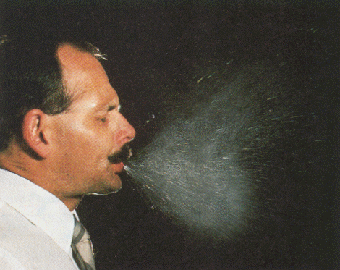
Employee Illness Reporting Agreement
2013 Food Code Requirement

Slide 11
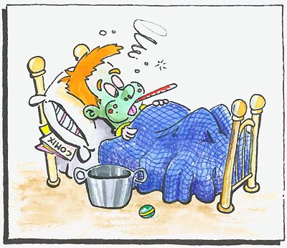
Employee Illness Reporting Agreement
The Food Employee must report to the Person in charge any of the following symptoms:
  Diarrhea
  Vomiting
  Jaundice
  Sore throat with fever
  Lesions containing pus on the hand, wrist, or an exposed body part not properly covered (such as boils and infected cuts, wounds, or lesions, however small)

Slide 12
The Big 6 Reportable Illnesses
Need to self-report to the health department if/when employees have the following reportable illnesses:
  Hepatitis A
  Typhoid Fever (Salmonella Typhi)
  Non-typhoidal Salmonella
  STEC (Shiga toxin-producing E. coli)
  Norovirus
  Shigella

Slide 13
Hepatitis A
What is Hepatitis A – Vaccine-preventable communicable disease of the liver
Symptoms – fatigue, low appetite, stomach pain, nausea, and jaundice
Incubation period – 14-28 days (period between exposure to infection and the appearance of the first symptoms)
How is it spread – Person-to-person through fecal-oral route or consumption of contaminated food or water
How long are you sick – 2 months (antibodies last a lifetime once infected)
How prominent – estimated 4,000 cases in U.S. in 2016 (Many states are currently experiencing outbreaks)
*information from Center for Disease Control

Slide 14
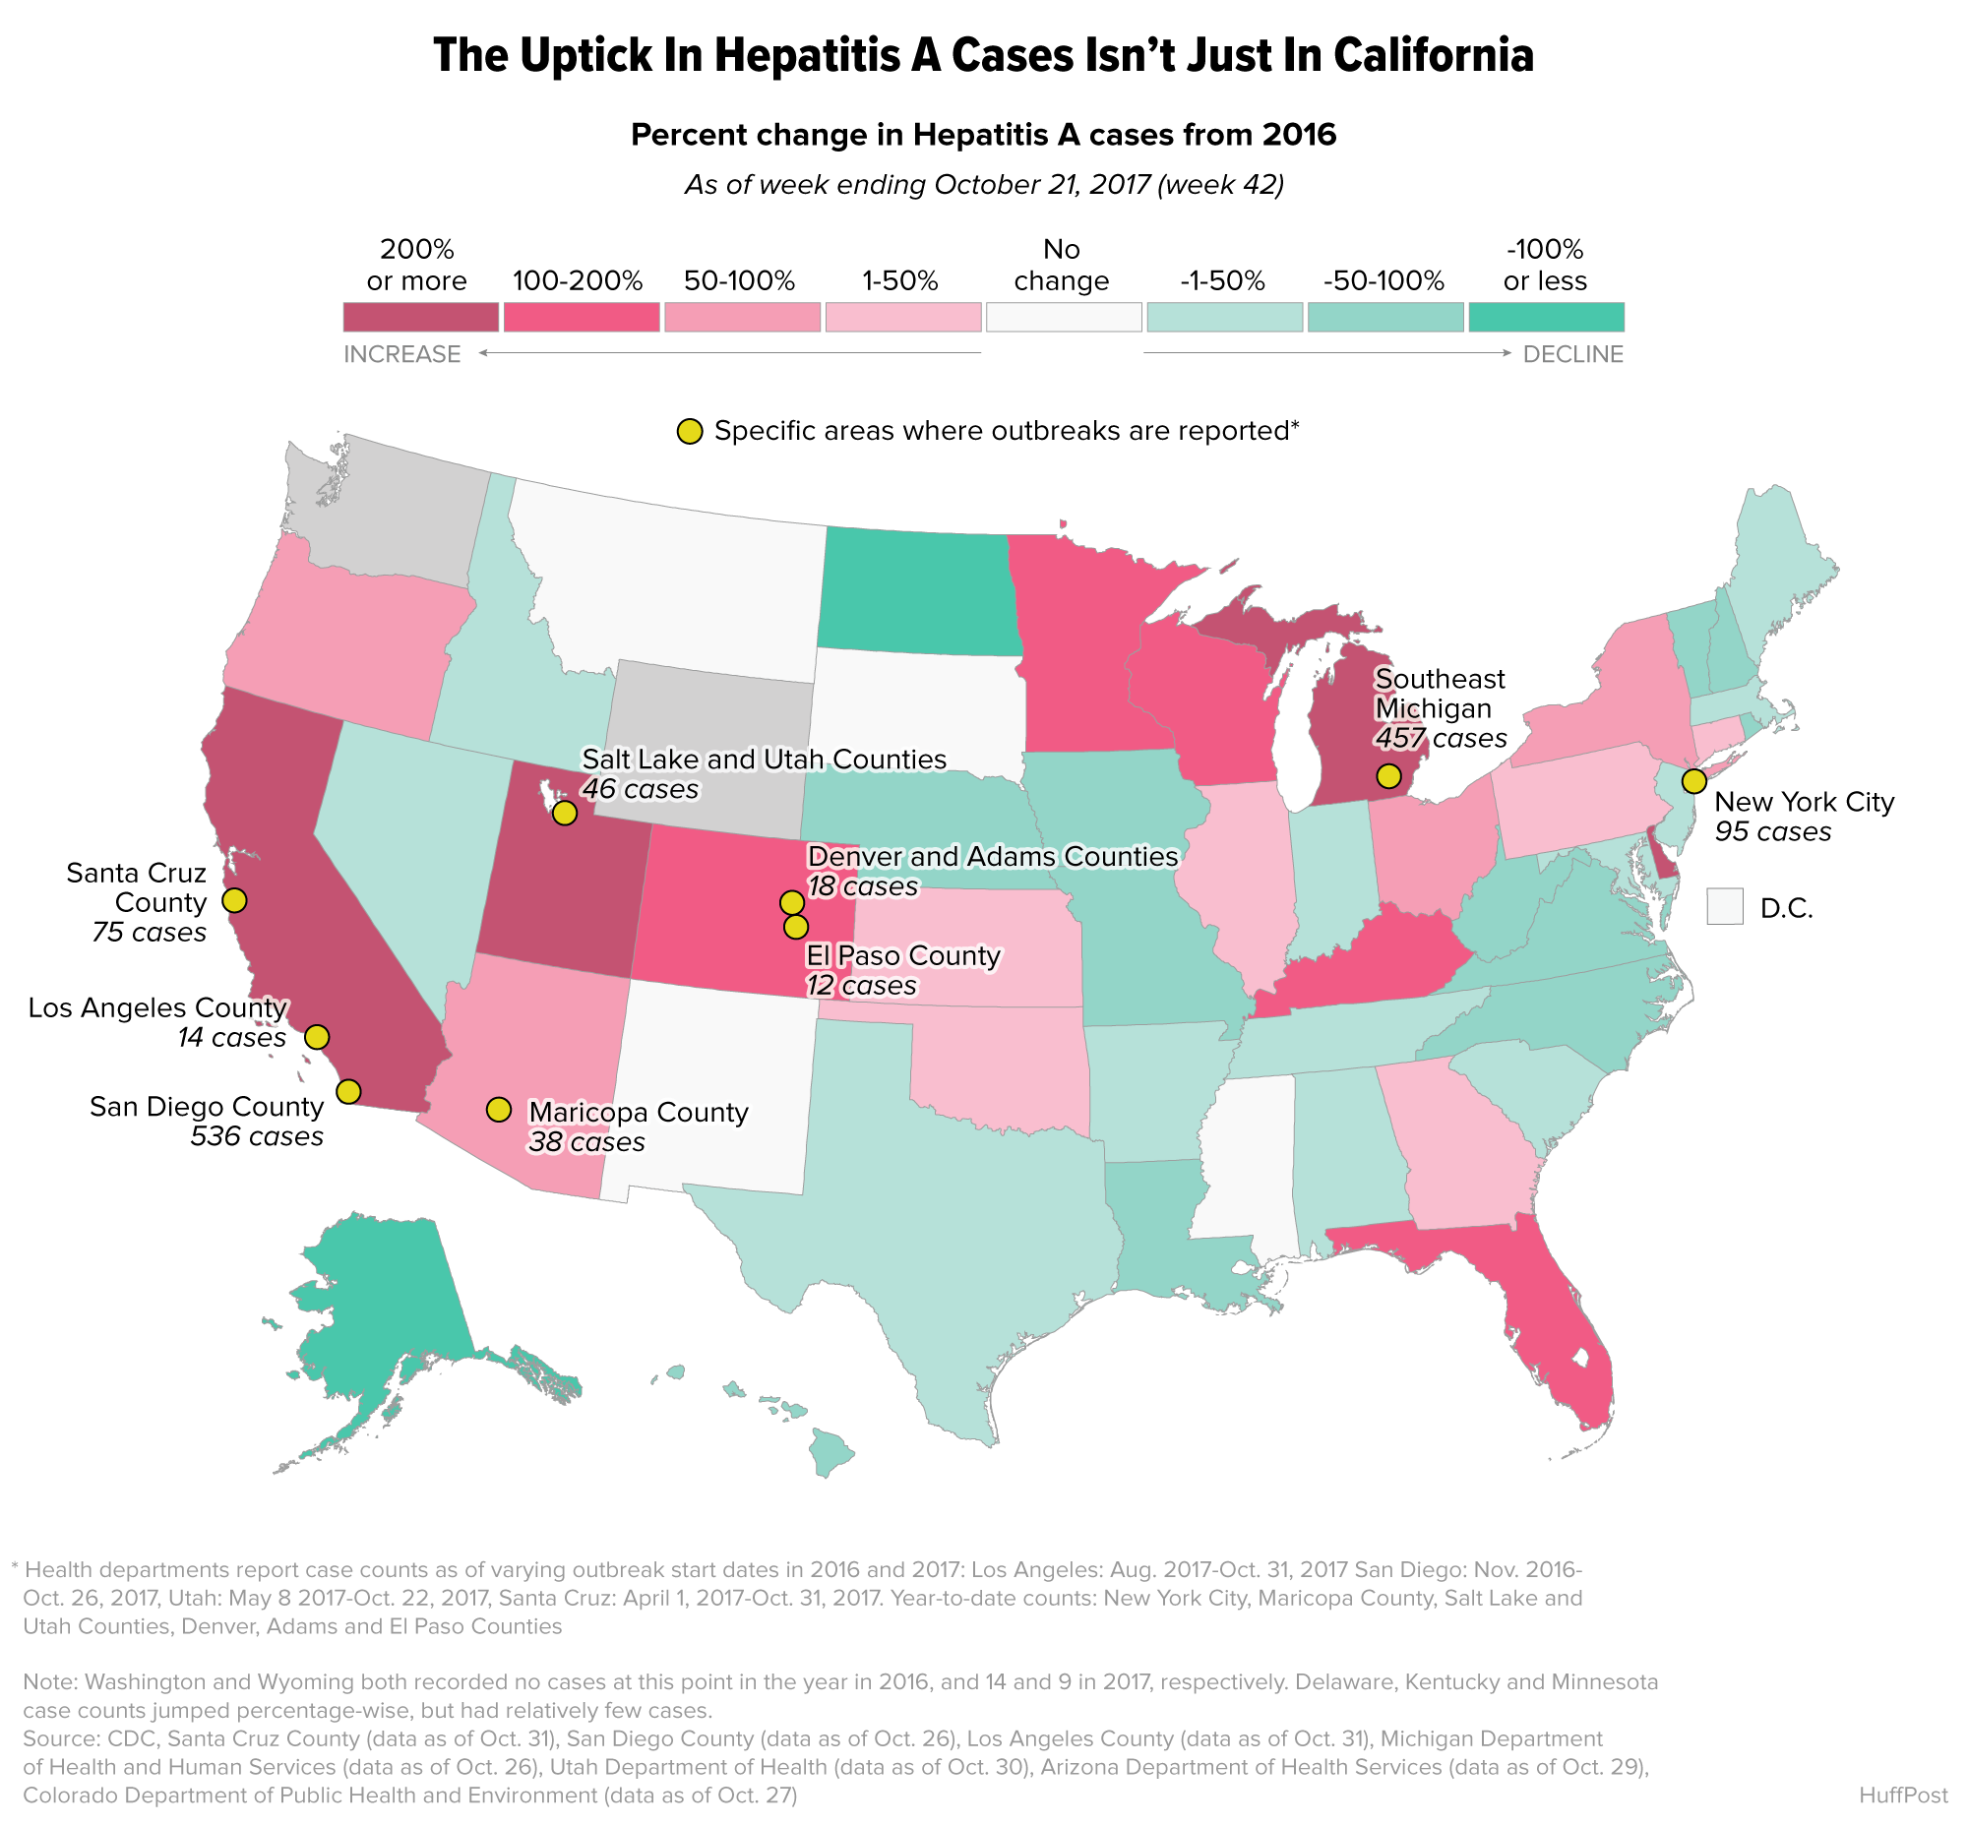

Slide 15

Typhoid Fever (S. Typhi)
What is Typhoid Fever – Life threatening illness caused by the bacterium Salmonella Typhi
Symptoms – High fever, weakness, stomach pains, headache and loss of appetite
Incubation period – 8-14 days
How is it spread – It lives only in humans and they carry the bacteria in their bloodstreams and intestinal tract and you get it by eating contaminated food and water that was handled by a person shedding bacteria
How long are you sick – weeks or months without antibiotic therapy
How prominent – an estimated 5,700 cases occur each year in the US, most cases (up to 75%) are acquired while traveling internationally and it is still common in the developing world where it affects about 21.5 million people each year
*information from Center for Disease Control

Slide 16
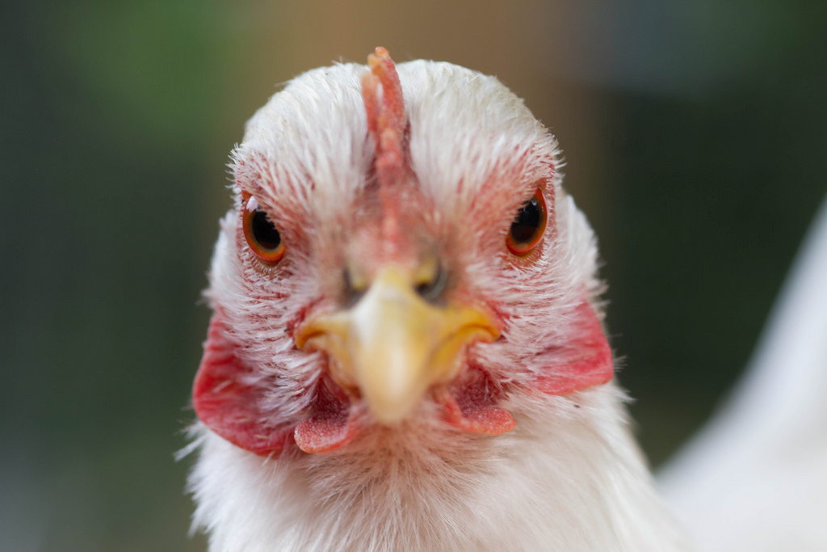

Non-typhoidal Salmonella
What is Nontyphoidal Salmonella – illnesses caused by Salmonella species not previously referenced
Symptoms – diarrhea, fever, and abdominal cramps
Incubation period – 12-72 hours
How is it spread – food or water contaminated with bacteria (cross- contamination, undercooked food, person to person, reptiles and chickens)
How long are you sick – 4-7 days (most recover without treatment)
How prominent – 1.2 million illnesses, 23,000 hospitalizations, and 450 deaths in the US every year and food is the source for about 1 million of these illnesses
*information from Center for Disease Control

Slide 17

STEC (Shiga toxin-producing E. coli)
What is STEC – bacteria found in the environment, foods and intestines of people and animals Symptoms – severe stomach cramps, diarrhea (often bloody) and vomiting
Incubation period – 3 – 4 days
How is it spread – Person-to-person through fecal-oral route or
consumption of contaminated food or water
How long are you sick – 5-7 days
How prominent – 100,000 illnesses, 3,000 hospitalizations and 90 deaths
*information from Center for Disease Control

Slide 18
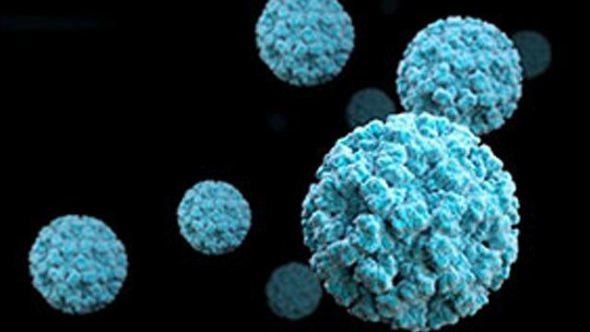
Norovirus
What is Norovirus – A very contagious virus that causes vomiting and diarrhea
Symptoms – Diarrhea, vomiting, nausea, stomach pain (fever, headache, body aches)
Incubation period - 12 – 48 hours
How is it spread – Person-to-person through fecal-oral route, vomit particles, consumption of contaminated food or water, or direct contact with someone infected with virus
How long are you sick – 1-3 days
How prominent – 19 to 21 million cases of acute gastroenteritis and leads to 1.7 to 1.9 million outpatient visits and 400,000 emergency department visits, primarily in young children - outbreaks occur most often from November to April
*information from Center for Disease Control

Slide 19
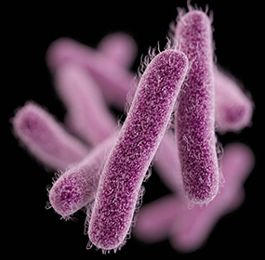
Shigella spp.
What is Shigellosis – Infectious disease caused by Shigella bacteria
Symptoms – Diarrhea, fever, and stomach cramps
Incubation period - 1–2 days
How is it spread – Person-to-person through fecal-oral route
or consumption of contaminated food or water
How long are you sick – 5-7 days
How prominent – 500,000 cases of diarrhea in the US annually
*information from Center for Disease Control

Slide 20
FDA Food Code Requirements –
Risk Factor/Interventions

Slide 21
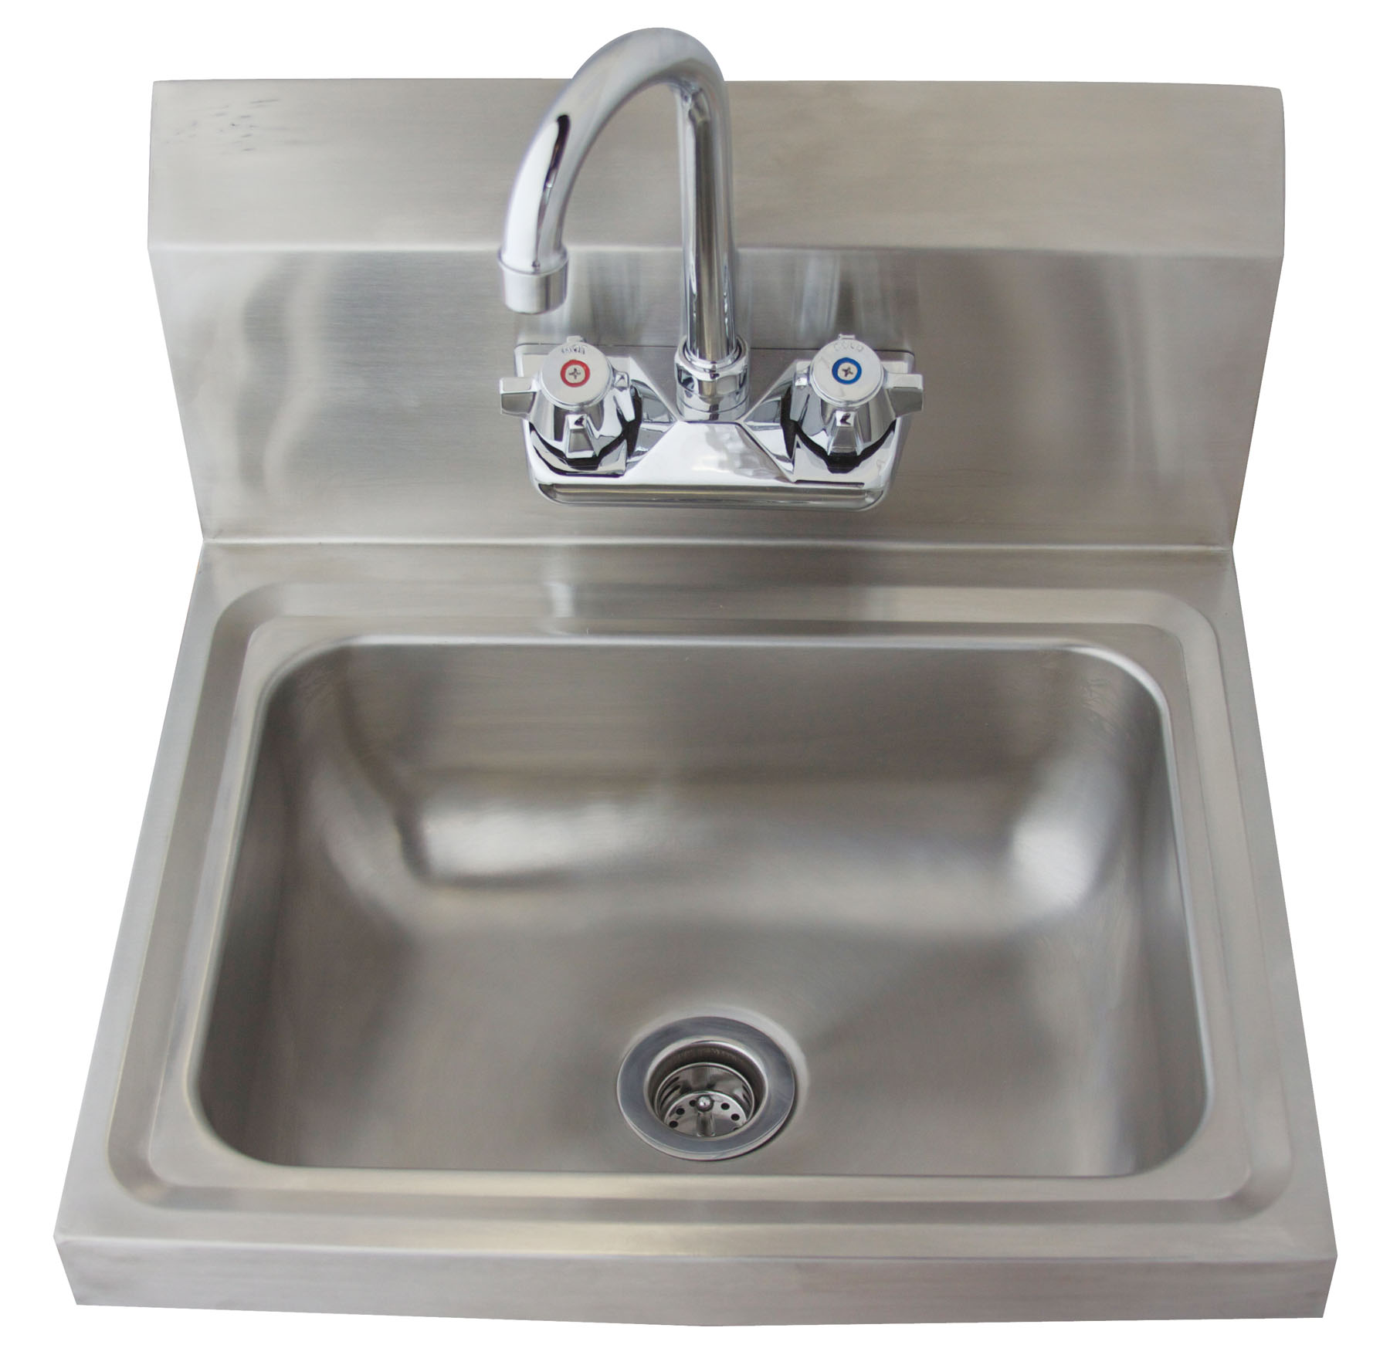
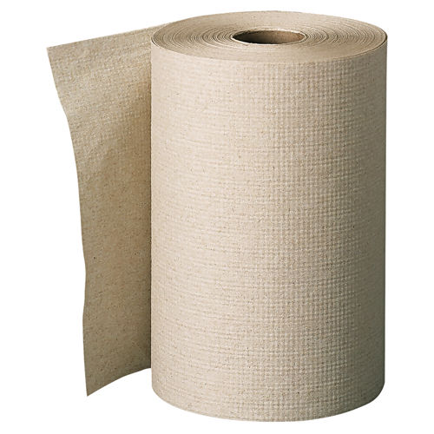
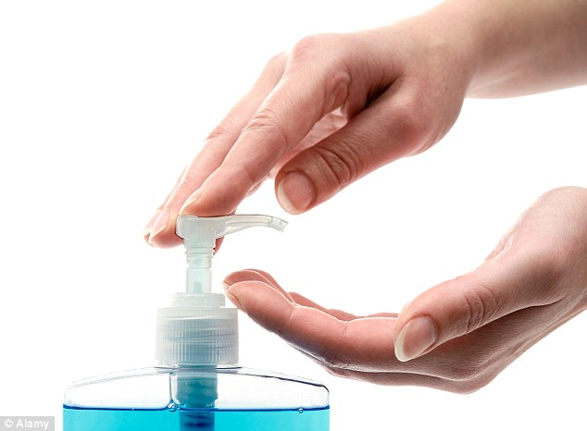
Hand Sinks and Hand Washing
+
+
Hand washing only!!
Must be available at each hand sink

Slide 22
Hand Washing Statistics
(according to the CDC)
Keeping hands clean is one of the most important steps we can take to avoid getting sick and spreading germs to others
Number of people with diarrhea; down 31%
Reduces diarrhea illness in people with weakened immune systems by 58%
Respiratory illnesses, like colds, down 16 – 21%
Reduces the amount of antibiotics used; reducing the likelihood of antibiotic resistance

Slide 23
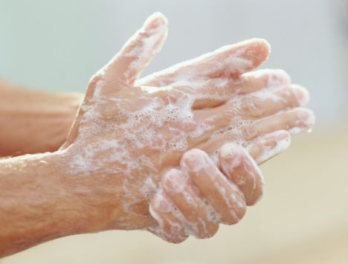
Hand Washing
Wash hands when entering the kitchen and between tasks before dawning gloves!
- scrub 10-15 seconds
- rinse with warm water
- dry with a disposable towel
- total time = 20 – 30 seconds

Slide 24
Proper Glove Use
Step 1: Wash Hands
Step 2: Put on Gloves
When Do I Change Gloves?
  When changing tasks (2013 Food Code)
  When handling different food
  To cover a bandaged cut
  When gloves become dirty/soiled
  Picking something up off of the floor, touching hair, taking a drink of water, etc.

Slide 25
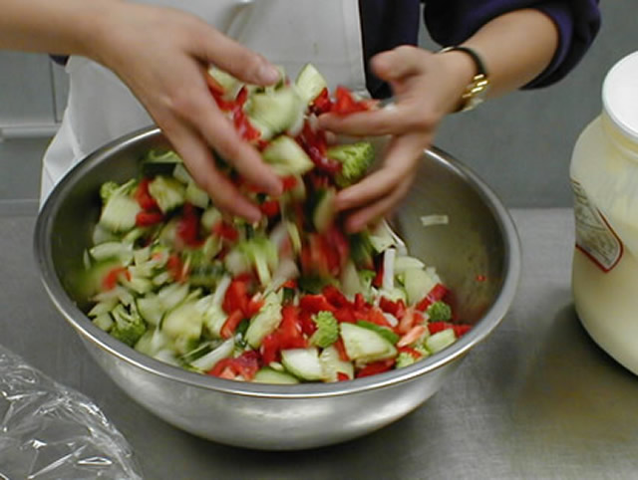
Handling Ready-to-Eat Food
NO BARE HAND CONTACT
Tongs
Gloves
Paper/tissue

Slide 26
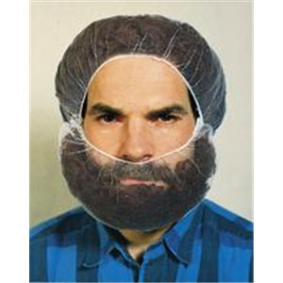
Hair Restraints
FDA Food Code: Food employees shall wear hair restraints such as hats, hair coverings or nets, beard restraints, and clothing that covers body hair…not applicable to counter staff serving only beverages and wrapped/packaged foods.

Slide 27
Proper Warewashing Procedure
(Wash – Rinse – Sanitize – Air Dry)
  Wash: removes dirt, germs, objects or impurities
  Rinse: removes food debris along with soap
  Sanitize: insures that the surface is free of pathogenic microbes
  Air Dry: dishes must be allowed to air dry before stacking (no towel drying like at home)

Slide 28
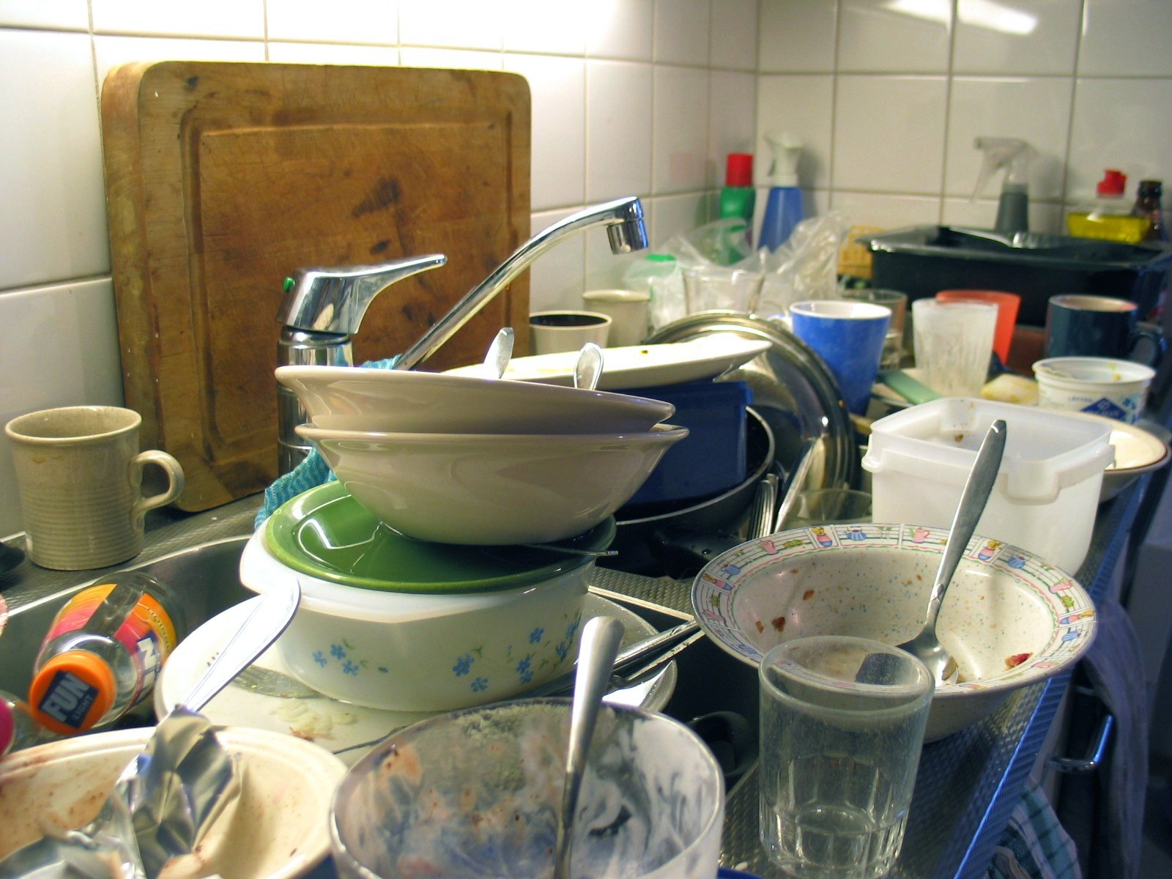
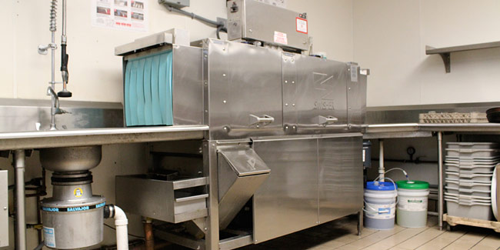
Proper Handling of Clean and Dirty Dishes
Designate a clean and A dirty
dish crew/AREA or
Wash hands and put on new gloves (if necessary) before handling clean dishes

Slide 29
Common Sanitizers
Quaternary Ammonium (Quat)
  Greater than 200 ppm concentration
    + excellent wide range germ killer; film forming residue; low toxicity & corrosivity, no odor, good shelf life (usually mixed automatically)
    - high price compared to bleach
Chlorine (bleach)
  Between 50 to 100 ppm concentration
  + inexpensive in comparison to quat
  - corrodes most metals, dissolves paper, cloth, other organic materials, could produce toxic chlorine gas if reacting with
  acids, peroxides and some other chemicals
- Follow manufactures instructions when mixing sanitizer solutions
Notes:
USDA List of approved sanitizer for organic food contact surfaces: 1. Chlorine 2.Hydrogen peroxide 3.Ozone 4.Peracetic acid/peroxyacetic acid 5.Phosphoric acid 6.Potassium hydroxide 7.Sodium hydroxide

Slide 30
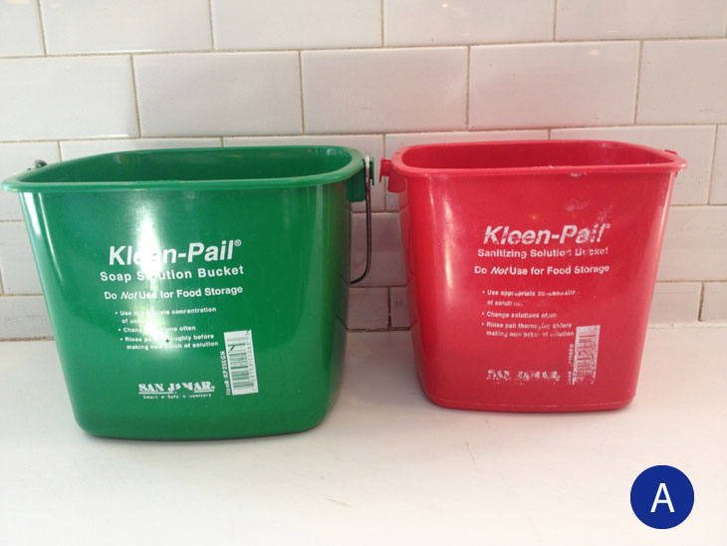
Sanitizer Buckets – Green vs. Red
Wiping cloths should not be stored in detergent buckets.
Wiping cloths are stored in sanitizer buckets to inhibit bacteria growth on the cloths
Detergent
Sanitizer
Notes:
33-33-04-51 Wiping cloths & working containers – 1. cloths used for wiping food spills and food-contact surfaces of equipment must be clean and stored in sanitizing solution; 2. cloths used for cleaning nonfood-contact surfaces of equipment, dining tables etc. must be clean and stored in sanitizing solution between uses.

Slide 31
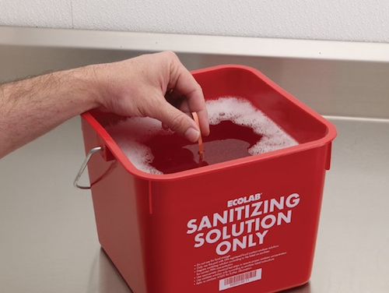

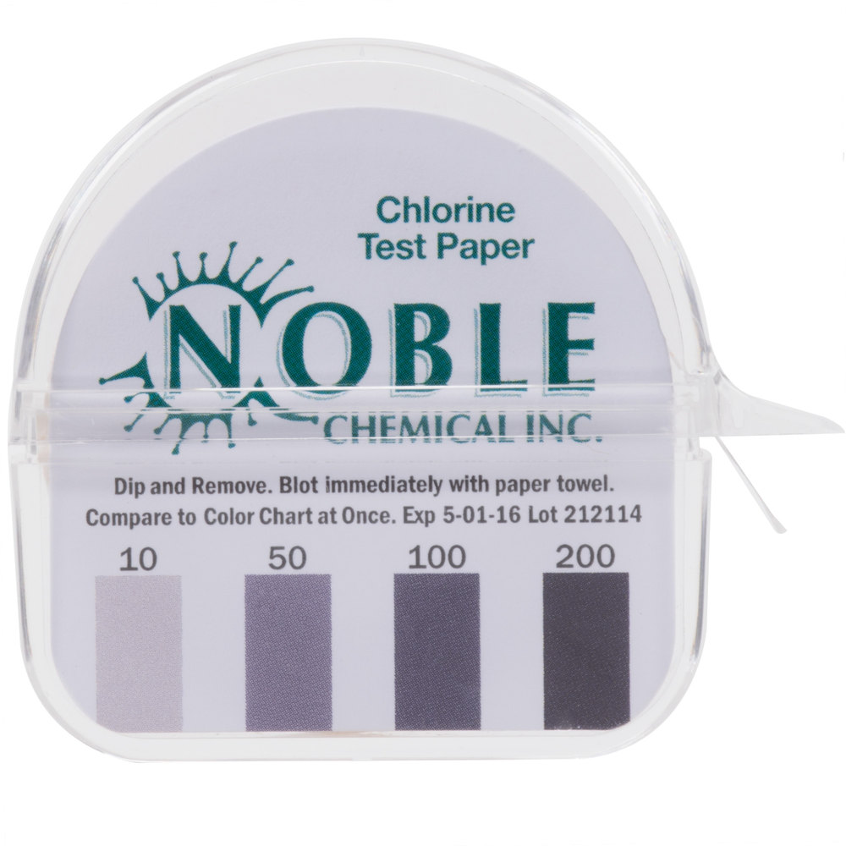
Sanitizer Test Strips
Test strips need to be available
- Employees need to know where the test strips are located and how to use them

Slide 32
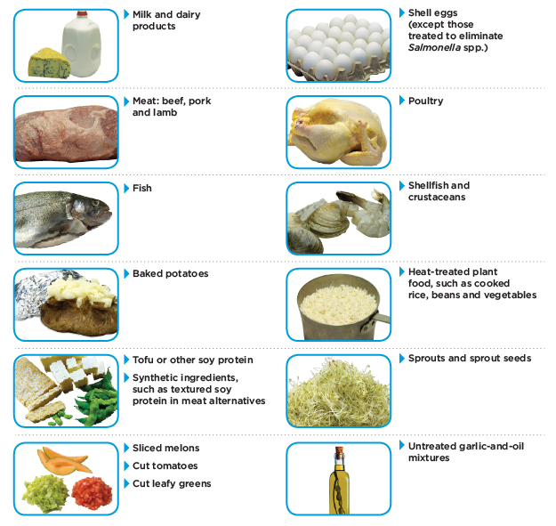
TCS
(Time and Temperature Controlled for Safety)

Slide 33
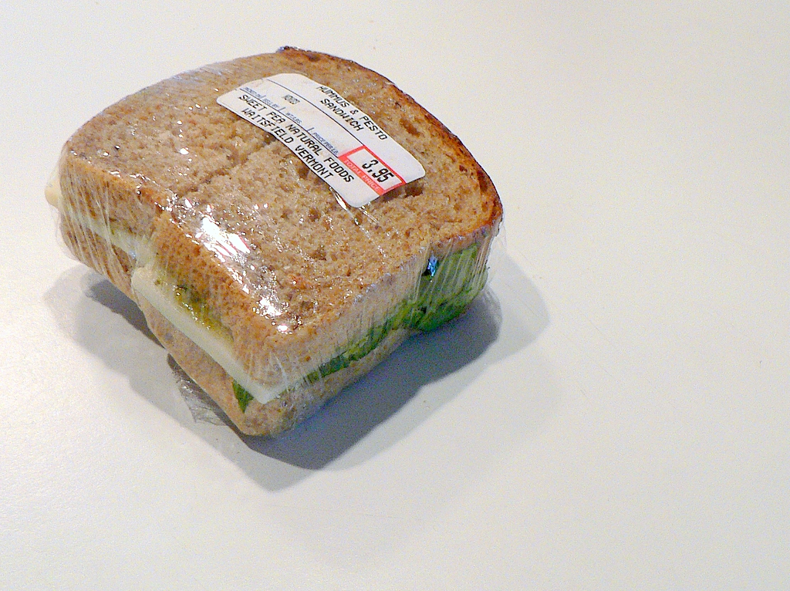

Cooling TCS foods Prior to Packaging or Storing

Slide 34

Safe Temperatures for TCS Foods
Keep cold food cold
DANGER ZONE
(4 hours max)
41º 135º
Keep hot food hot
Less than
41º
Greater than
135º
Notes:
Rapid growth and reproduction of bacteria in the danger zone

Slide 35
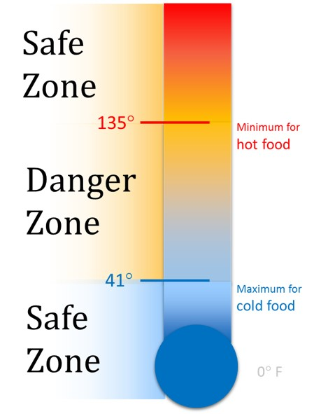

Slide 36
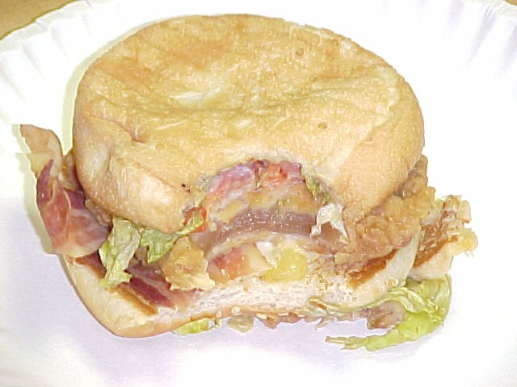
Thorough cooking of TCS foods

Slide 37
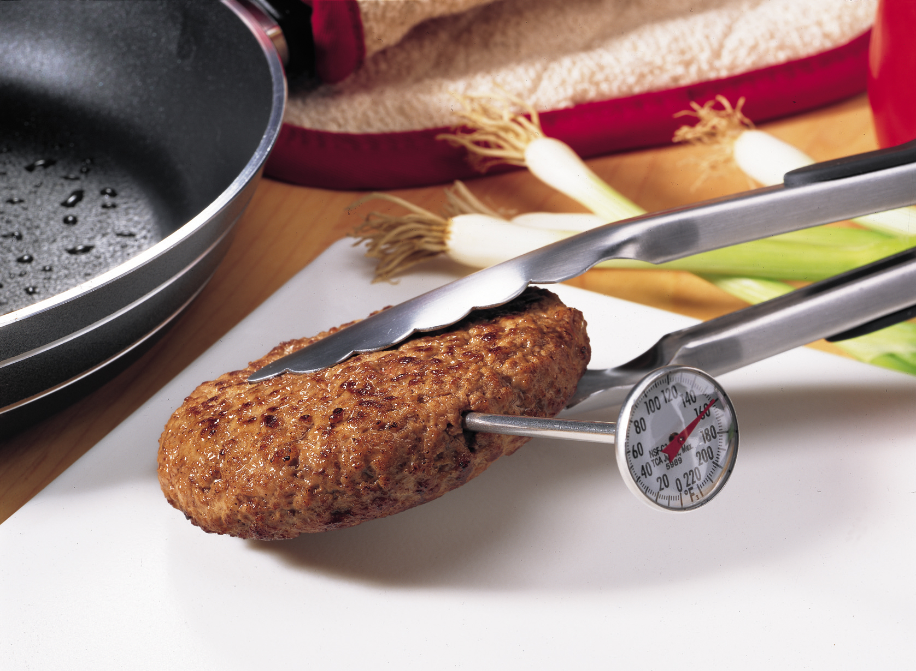
Reheating TCS foods for Hot Holding
TCS food that is cooked, cooled and reheated for hot holding should be reheated so that all parts of the food reach a temperature of 165º F for at least 15 seconds. Note: pre-processed foods can be heated to 135º for hot holding
Items must be hot held at
135º F or higher.

Slide 38
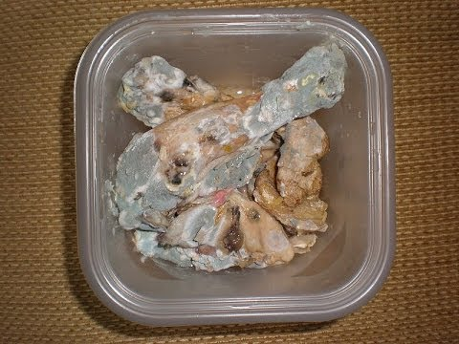
Using Time as a Public Health Control?
If TCS food is allowed to sit in the danger zone between 135º and 41º it must be discarded after
4 HOURS

Slide 39
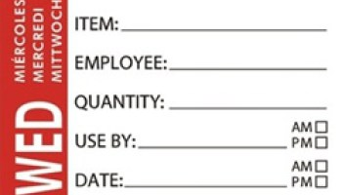
Date Marking of Ready to Eat TCS Food
SEVEN days stored at 41º F or less
Must be dated marked if stored longer than 24 hours
SEVEN days begins the day the TCS food is prepared or a commercial container is opened (the prep day is day 1)
When combining food in a dish with different use-by-dates, the discard date of the dish should be based on the earliest use-by date

Slide 40
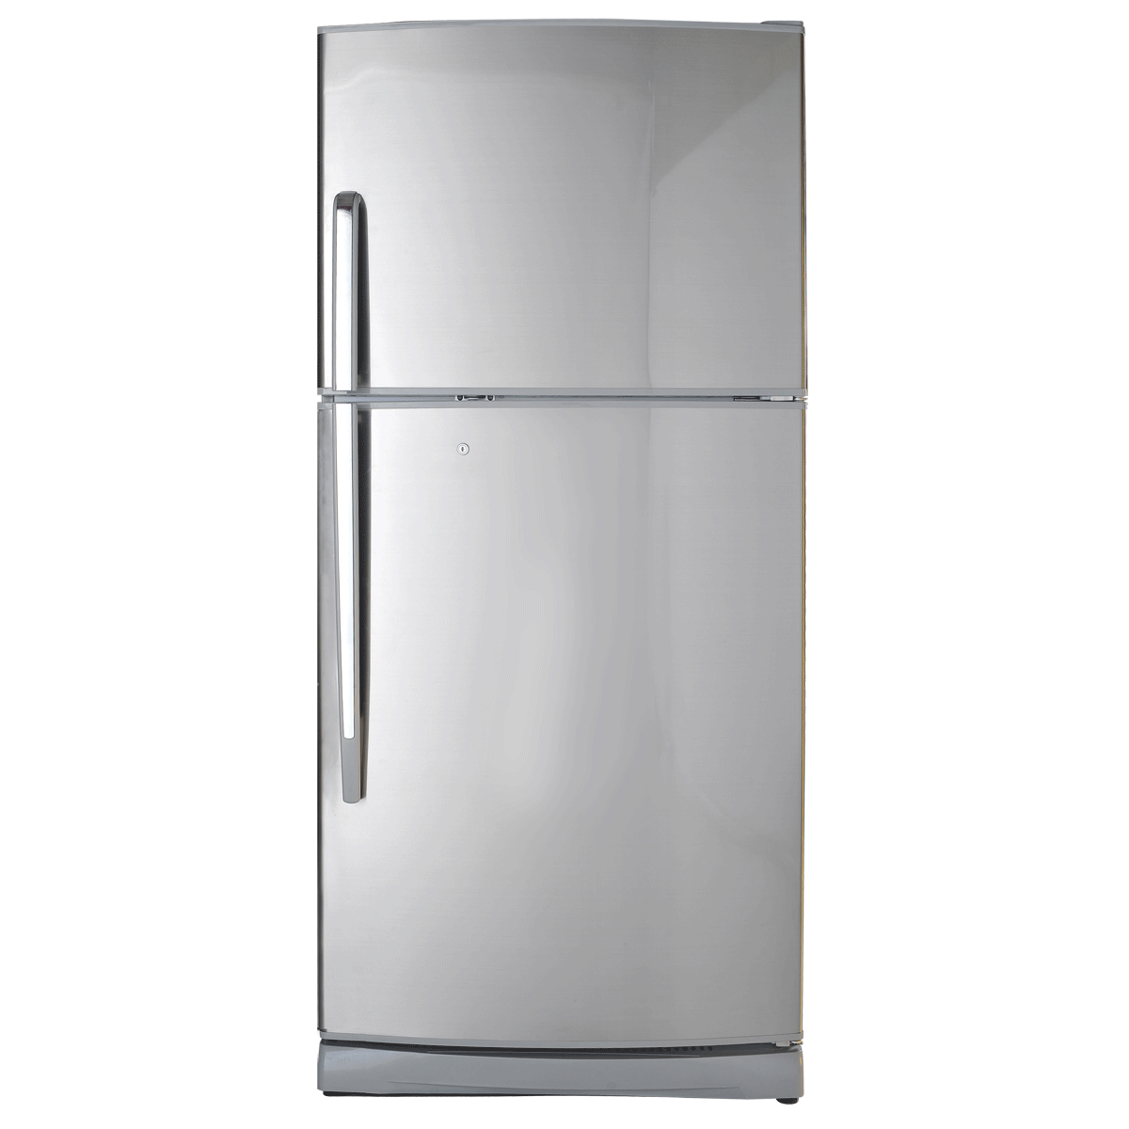
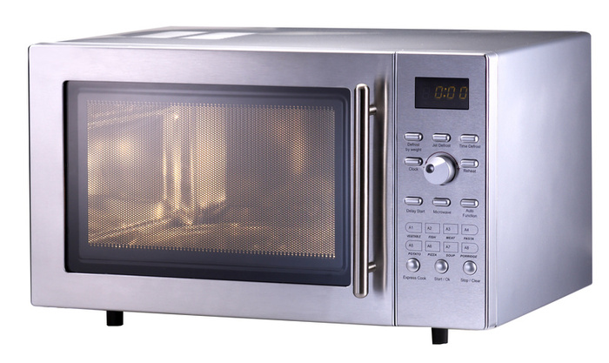
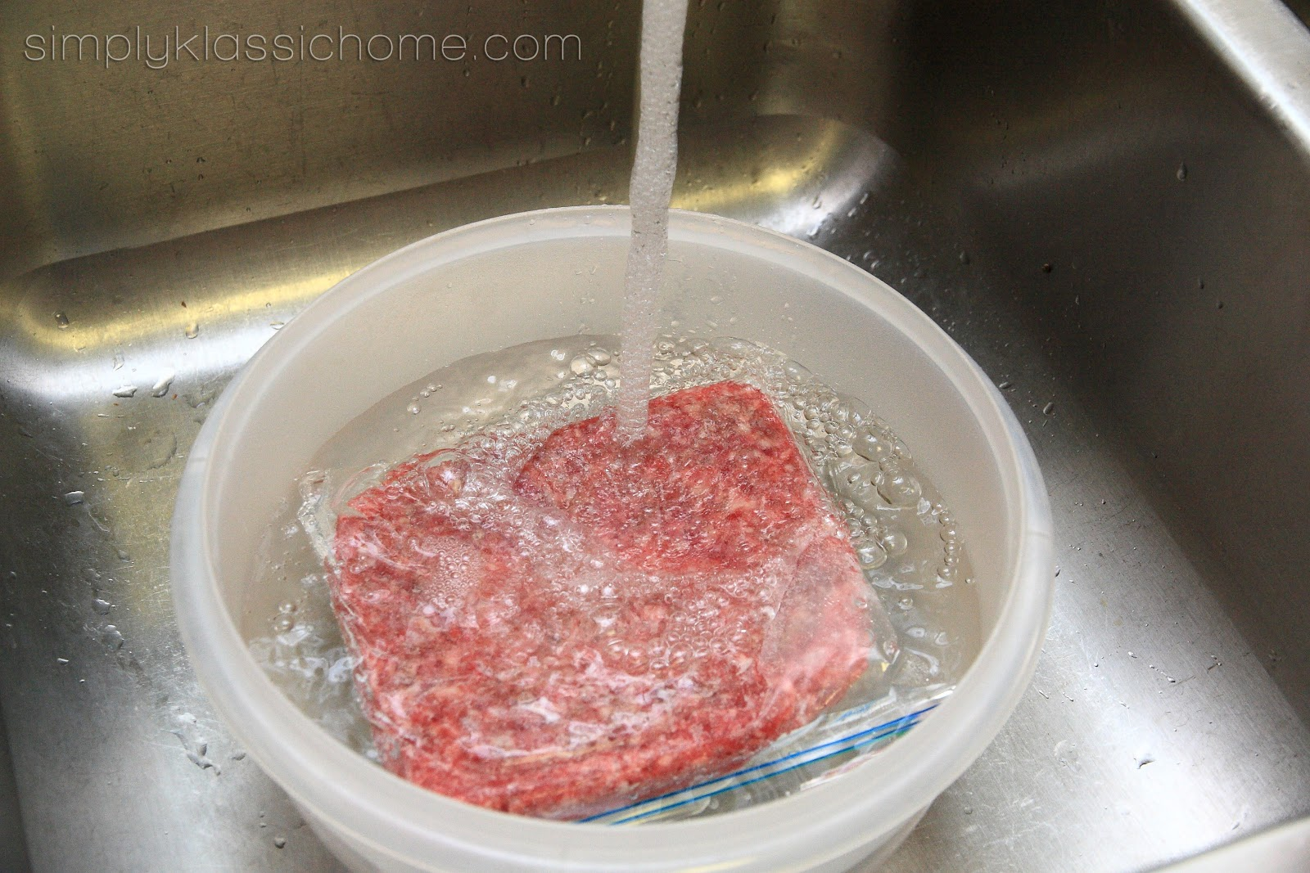
FDA Food Code Requirements
Thawing Frozen Food
Running Water
(70º F or cooler)
Microwave
(thaw & cook)
Refrigerator
(stays <41º F)

Slide 41
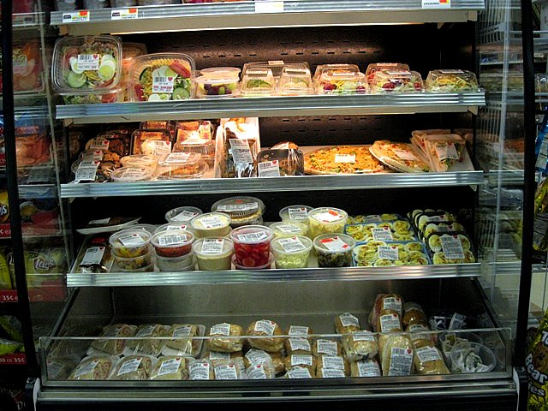
Open Air Coolers
Open air coolers are designed to cold hold not cool!
Prepare sandwiches/salads with cold ingredients
Cool prepared items to a safe temp. in a refrigerator before packaging and placing in the open air cooler

Slide 42
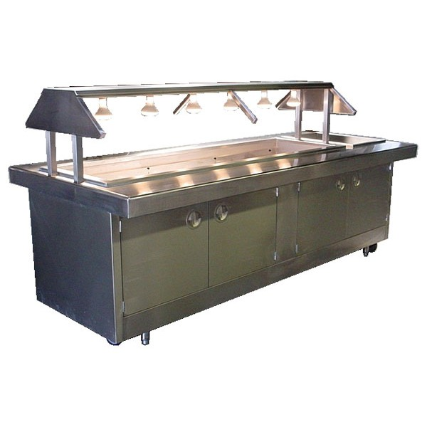
Buffet Tables
Properly heat or cool foods before placing on the buffet
Designed for cold/hot holding (not designed for cooling or heating)
Sneeze guards are required
Avoid loose clothing (i.e. winter jackets with attached gloves etc.)
Best to discard uneaten TCS food to avoid temperature abuse (4 hours)

Slide 43
Good Retail Practices
Good Retail Practices are preventative measures to control the addition of pathogens, chemicals, and physical objects into foods.

Slide 44
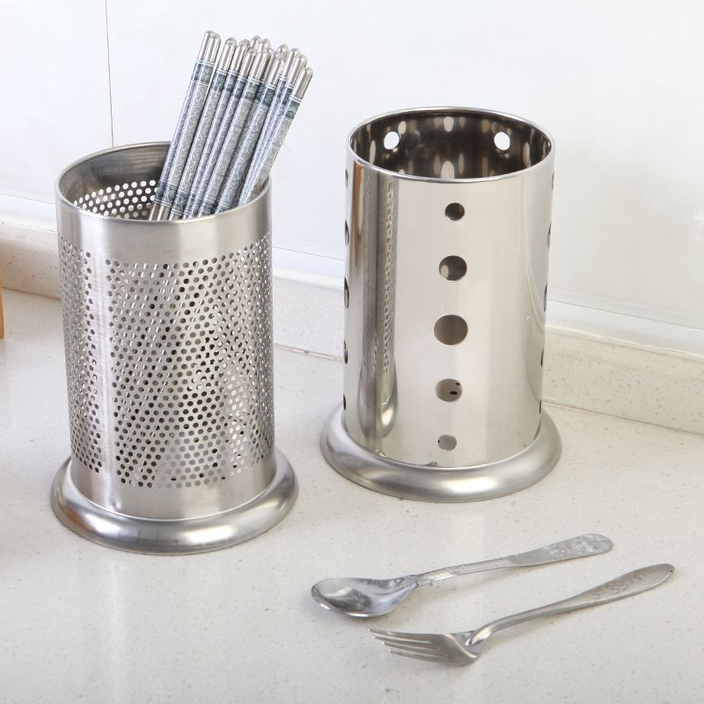

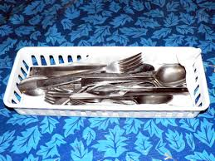
Store utensils handle up or facing one direction to minimize bare hand contact on the food contact area of the utensil

Slide 45


Personal Beverages in the Kitchen
good
Bad

Slide 46
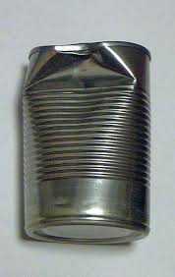
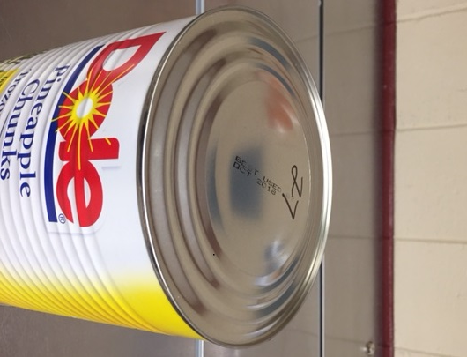
What About Dented or Bulging Cans?
  RETURN or DISCARD cans that have sharp dents or are bulging
  Why???
  A dent may cause a break in the seal allowing bacteria to grow inside the can.
  Clostridium botulinum (C.botulinum) in a bulging can, although rare, is a deadly bacteria.

Slide 47
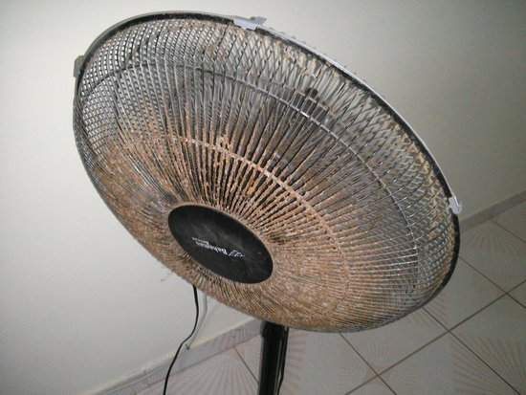
Make Sure To Schedule Cleaning for All Equipment in the Kitchen

Slide 48
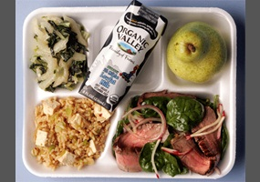
Once a food is sold it cannot come back to the kitchen and be re-sold

Slide 49
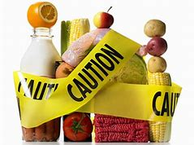
What is considered an outbreak?
In North Dakota, a foodborne outbreak is defined as:
-An incident in which two or more unrelated people experience a similar illness after ingestion of a common food and epidemiologic analysis implicates the food as the source of the illness.
-An unexplained, unexpected increase of a similar illness (cluster) and food is a likely source.

Slide 50

Investigation Process
A contact is made from the complainant, establishment and/or local epidemiologist concerning a possible foodborne illness
The local epidemiologist and EHPs gather more information pertaining to the possible foodborne illness
If it meets definition criteria, a complete investigation is conducted:
  Sample collection for analysis at state lab to determine infectious etiology (if available)
  Thorough review of the establishments policies, procedures and employee illness logs with a minimum of 2 EHPs
  Review of inspection history
  Interviews of additional patrons or staff
Final report generated and submitted to required parties

Slide 51
QUESTIONS / COMMENTS?

